Slide 1

DevOps
by
Girish Godbole

Slide 2
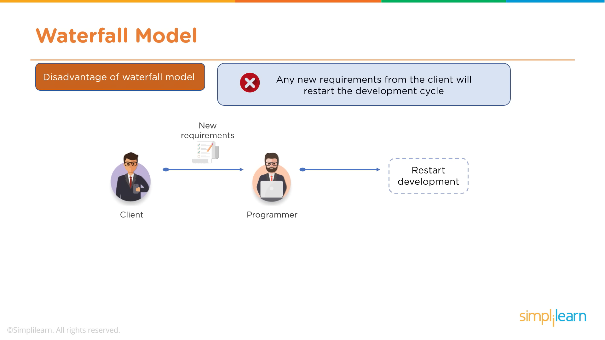
DevOps

Slide 3
DevOps

Slide 4
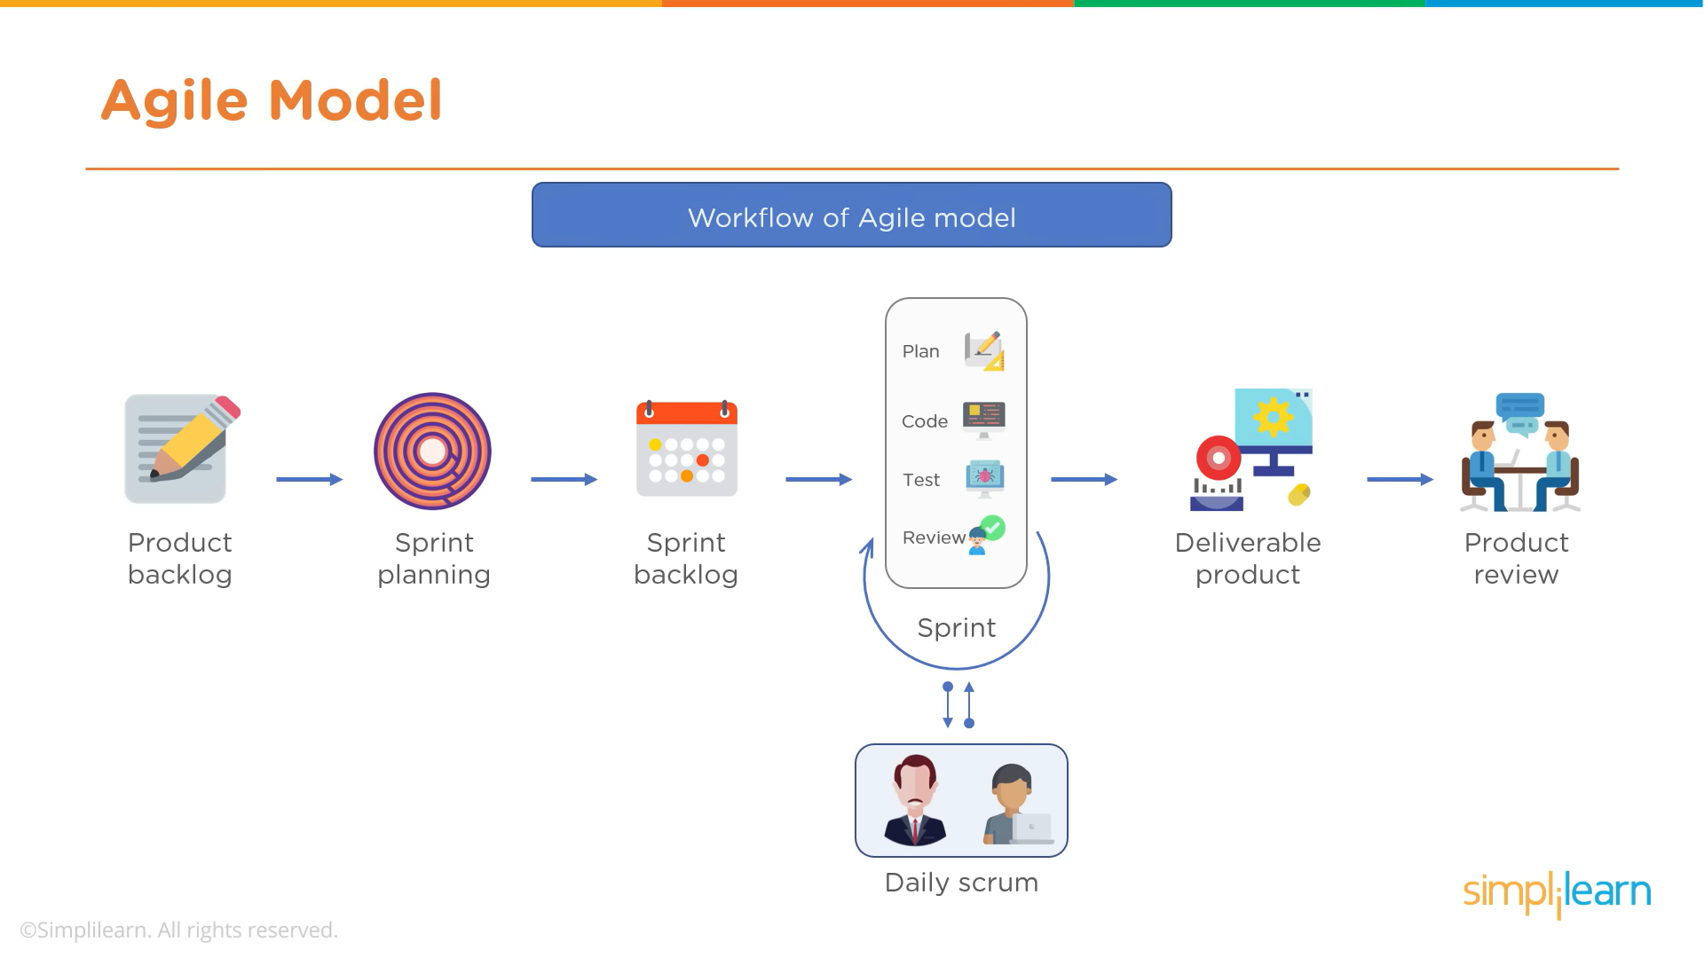
DevOps

Slide 5
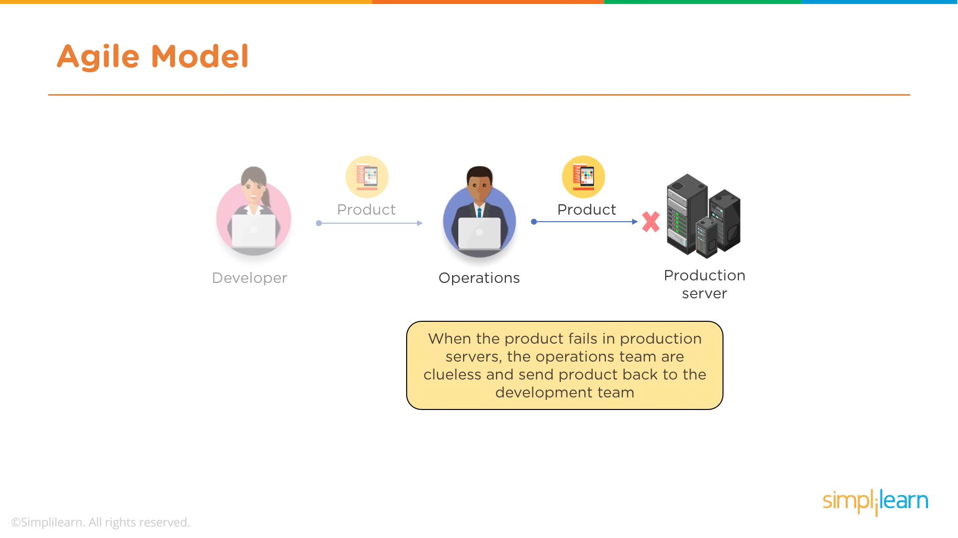
DevOps

Slide 6
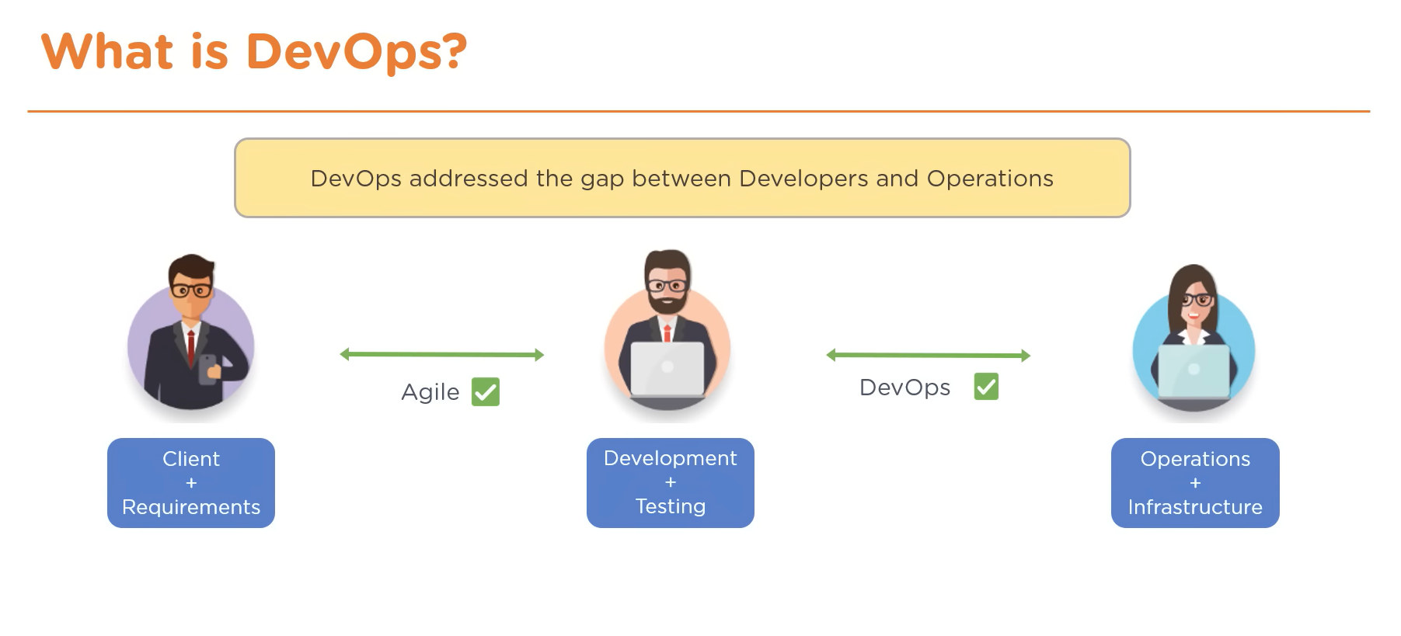
DevOps

Slide 7
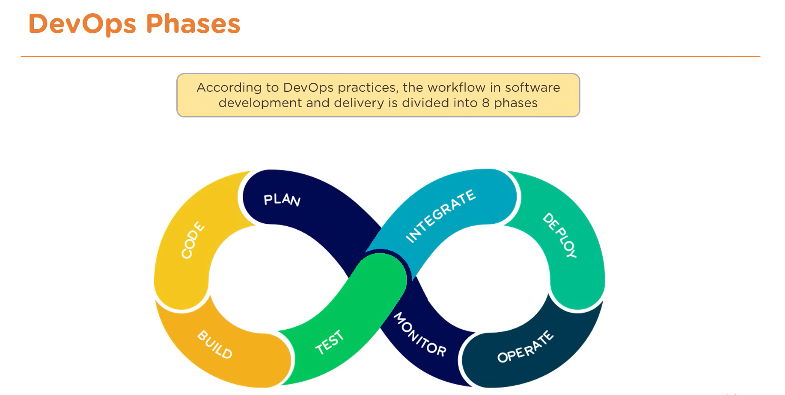
DevOps

Slide 8
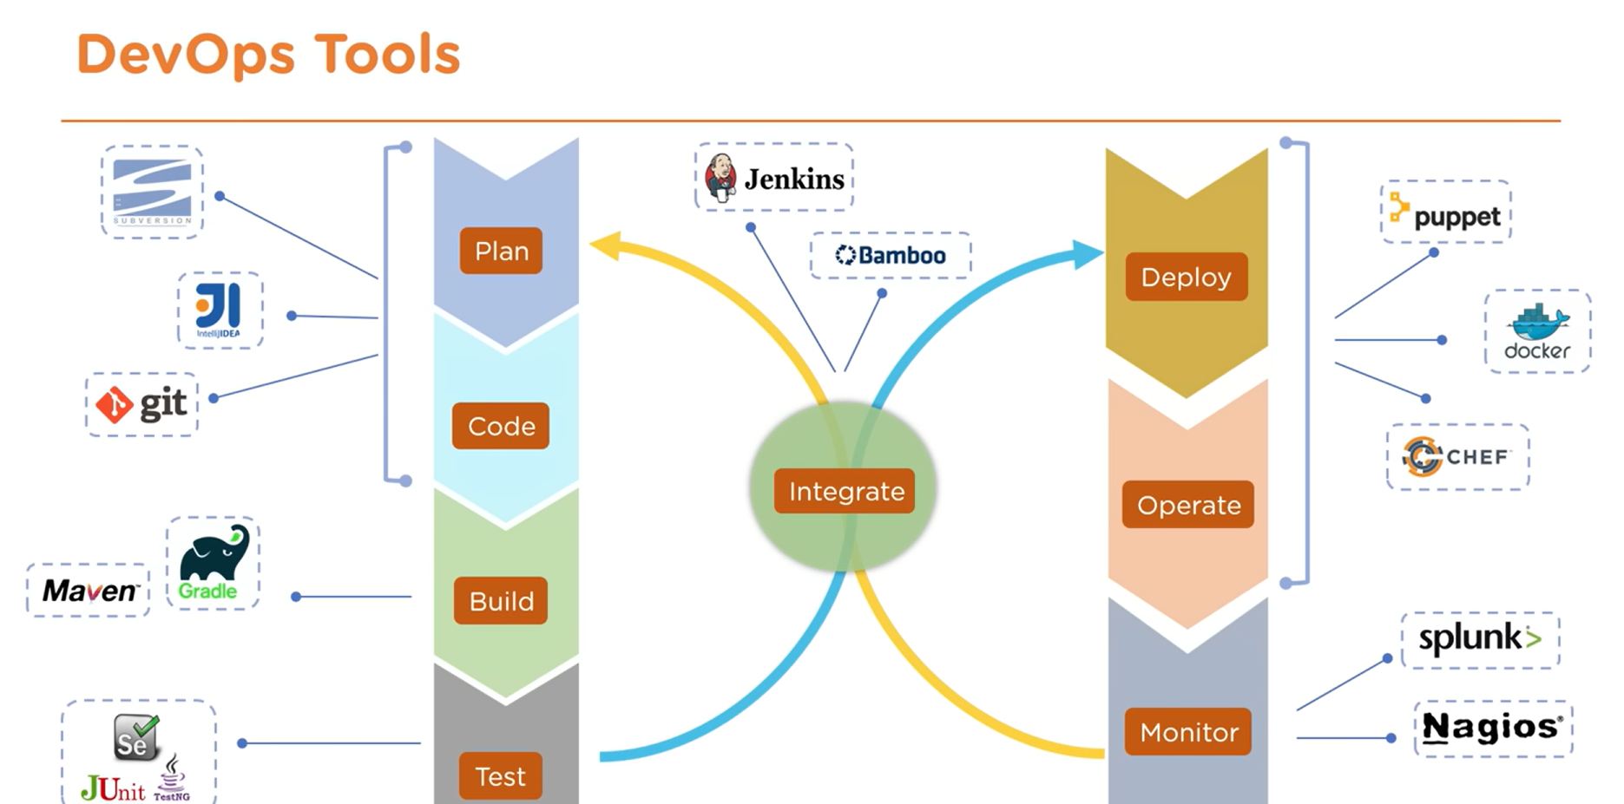
DevOps

Slide 9
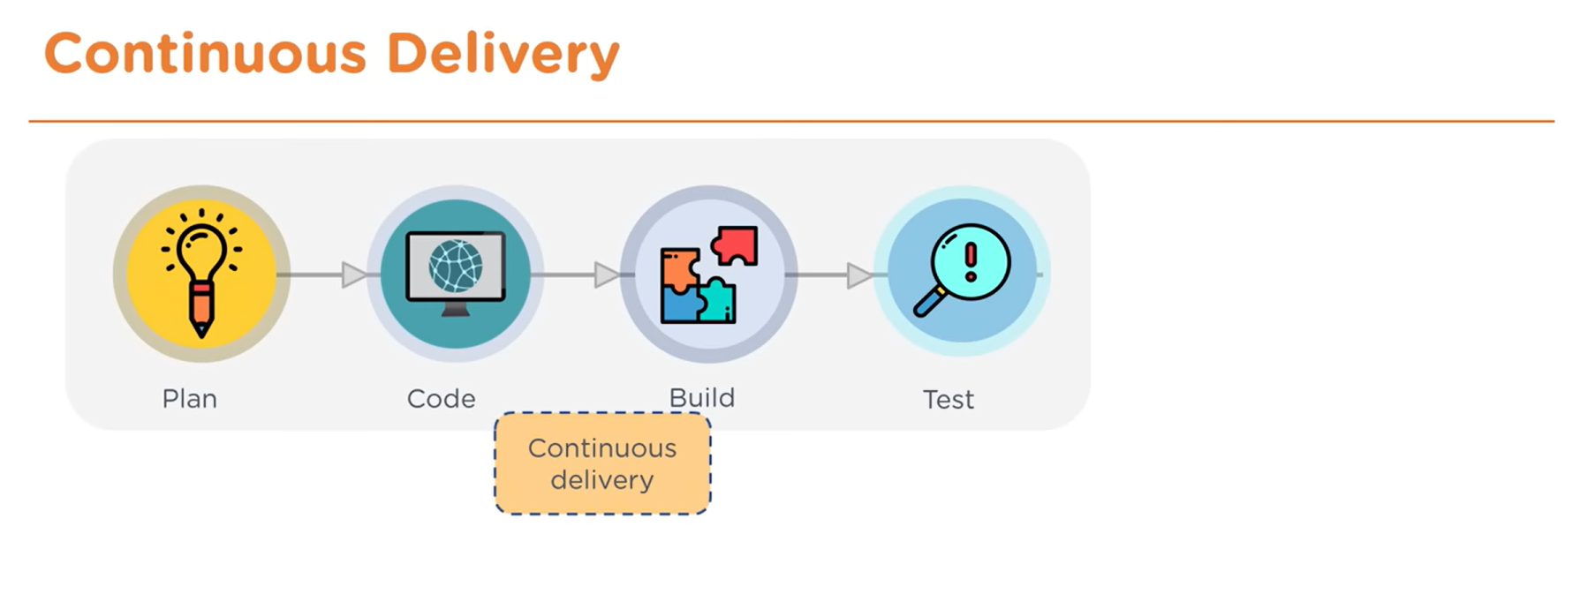
DevOps

Slide 10
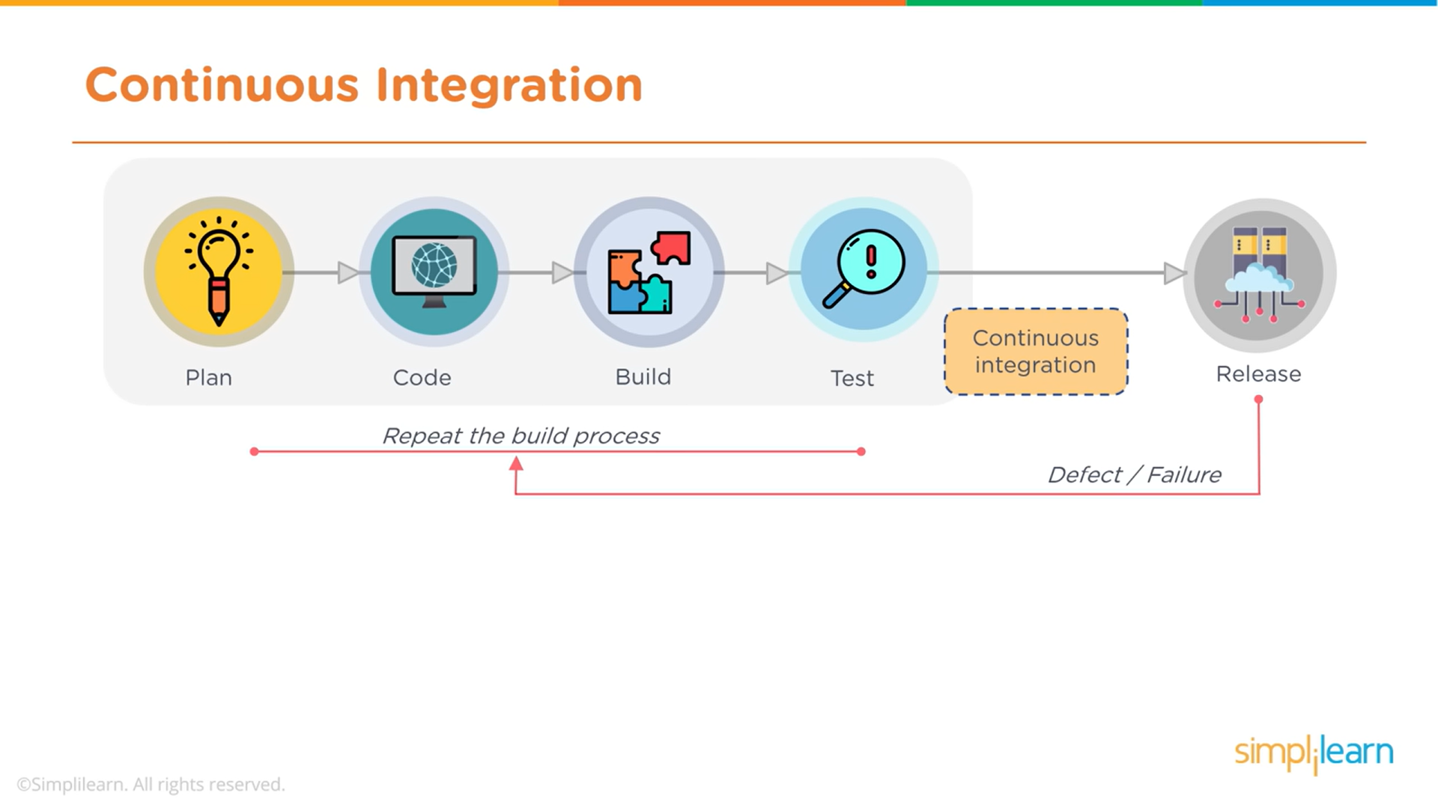
DevOps

Slide 11
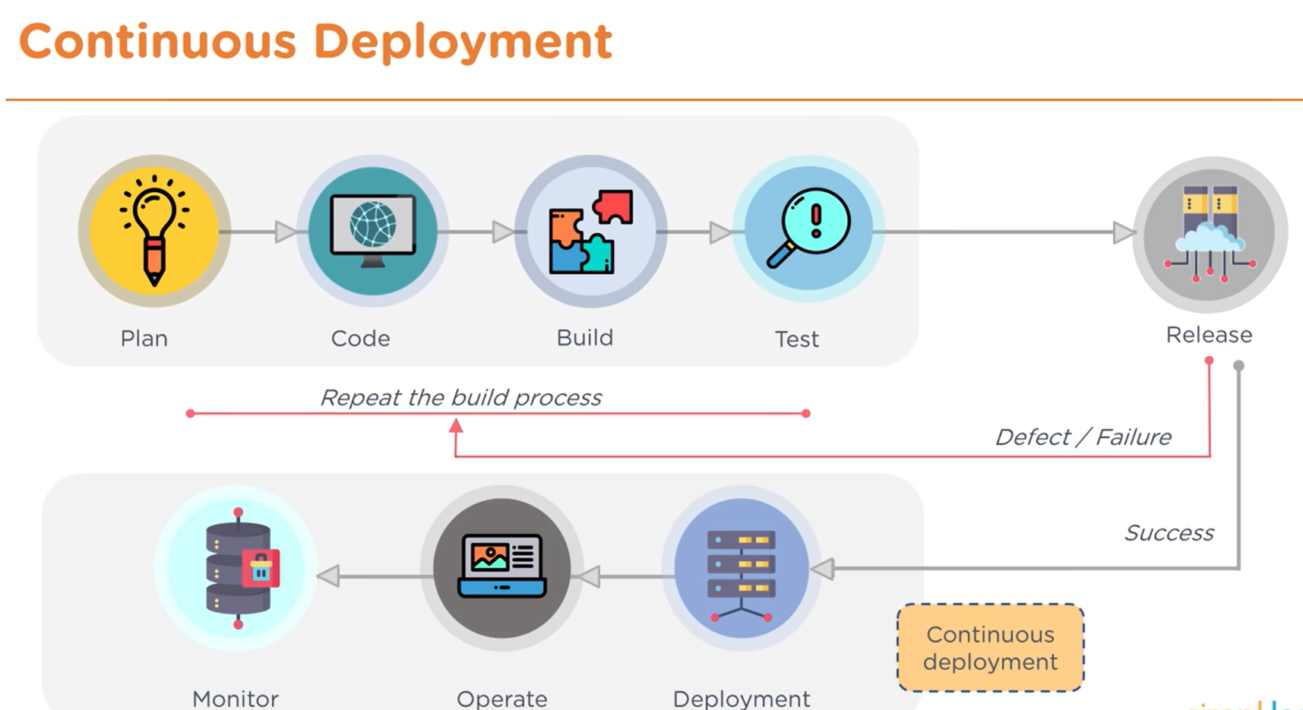
DevOps

Slide 12
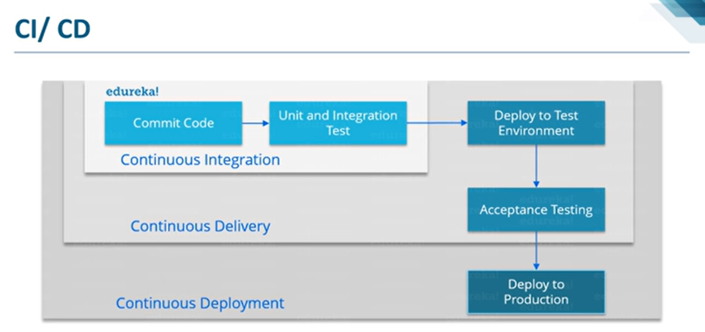
DevOps

Slide 13
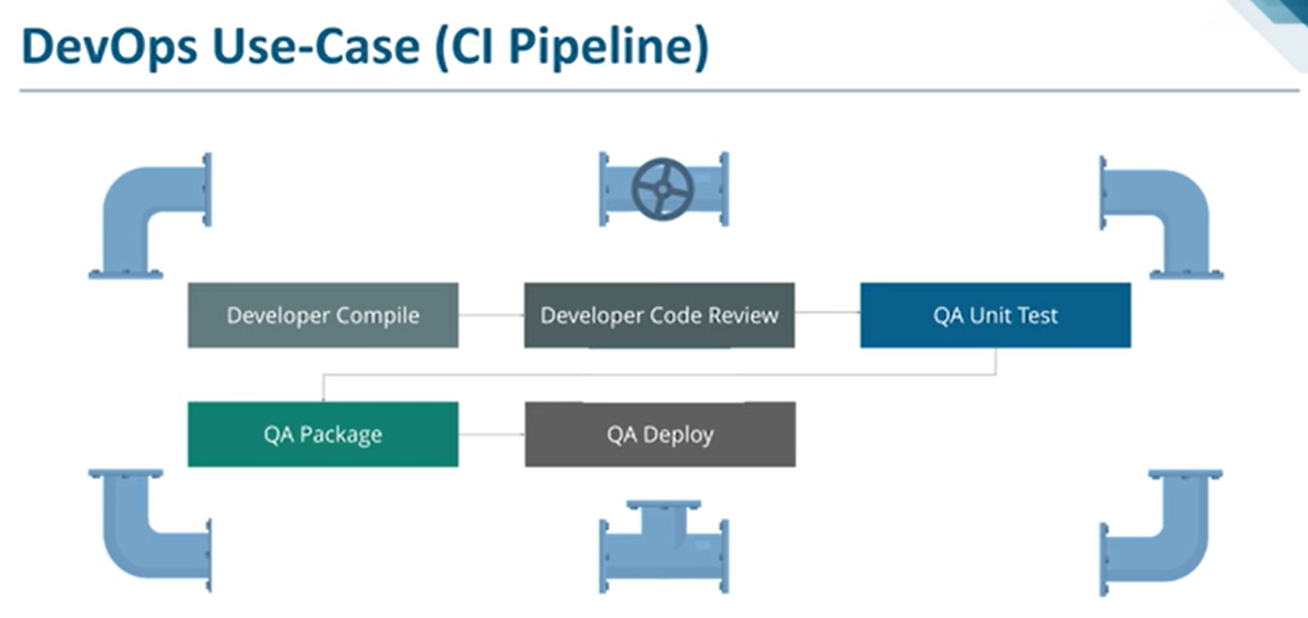
DevOps

Slide 14
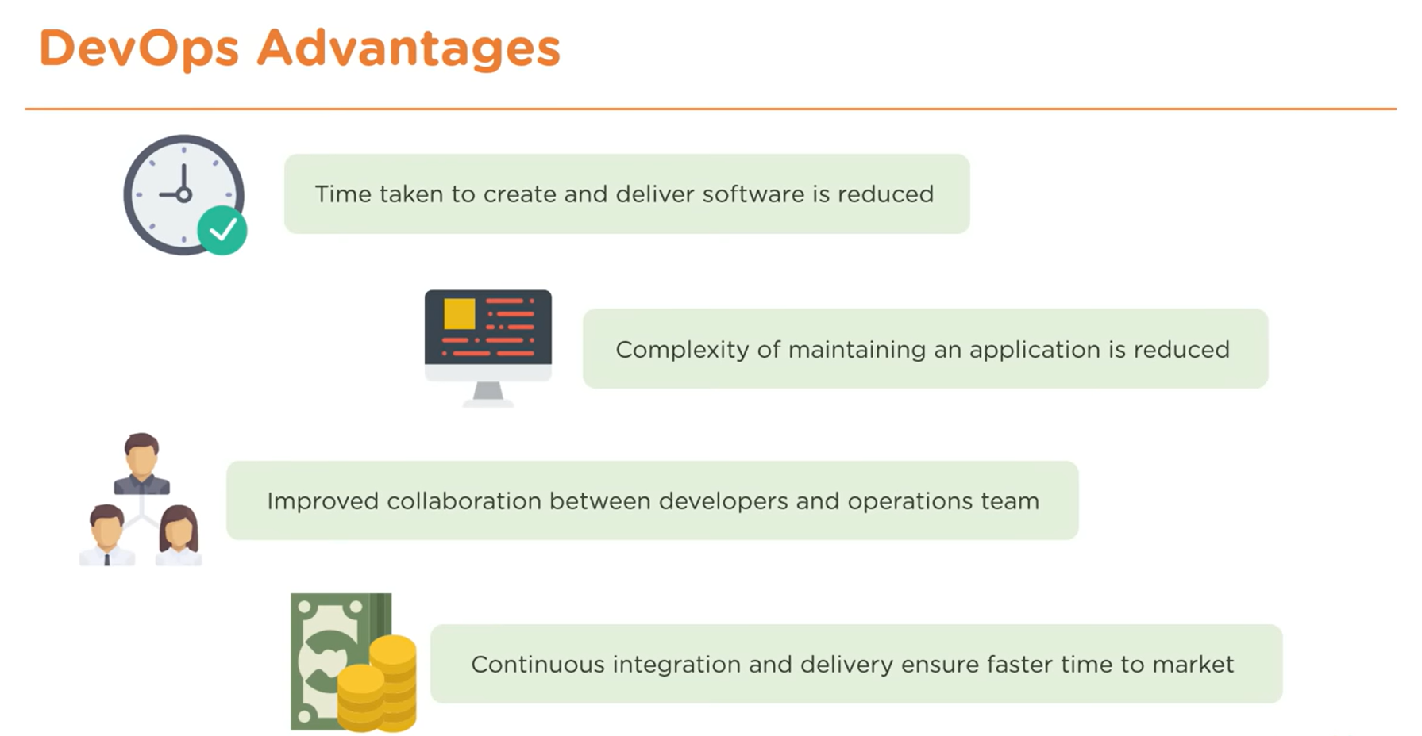
DevOps

Slide 15
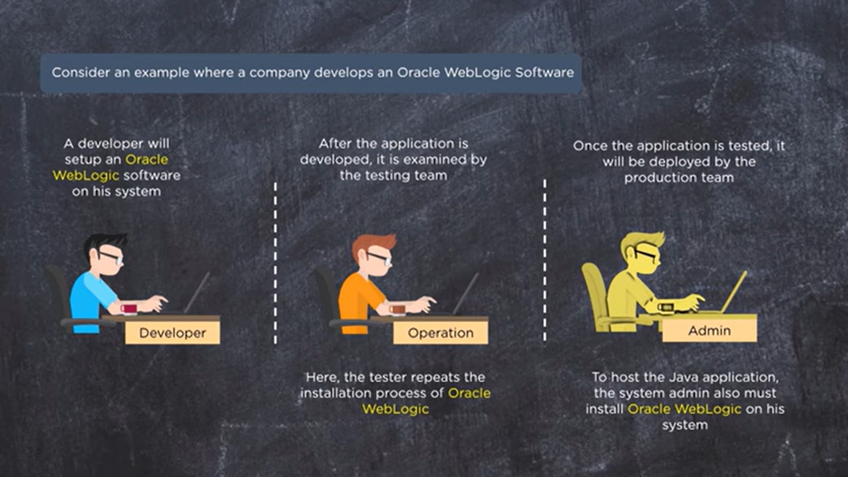
Docker

Slide 16
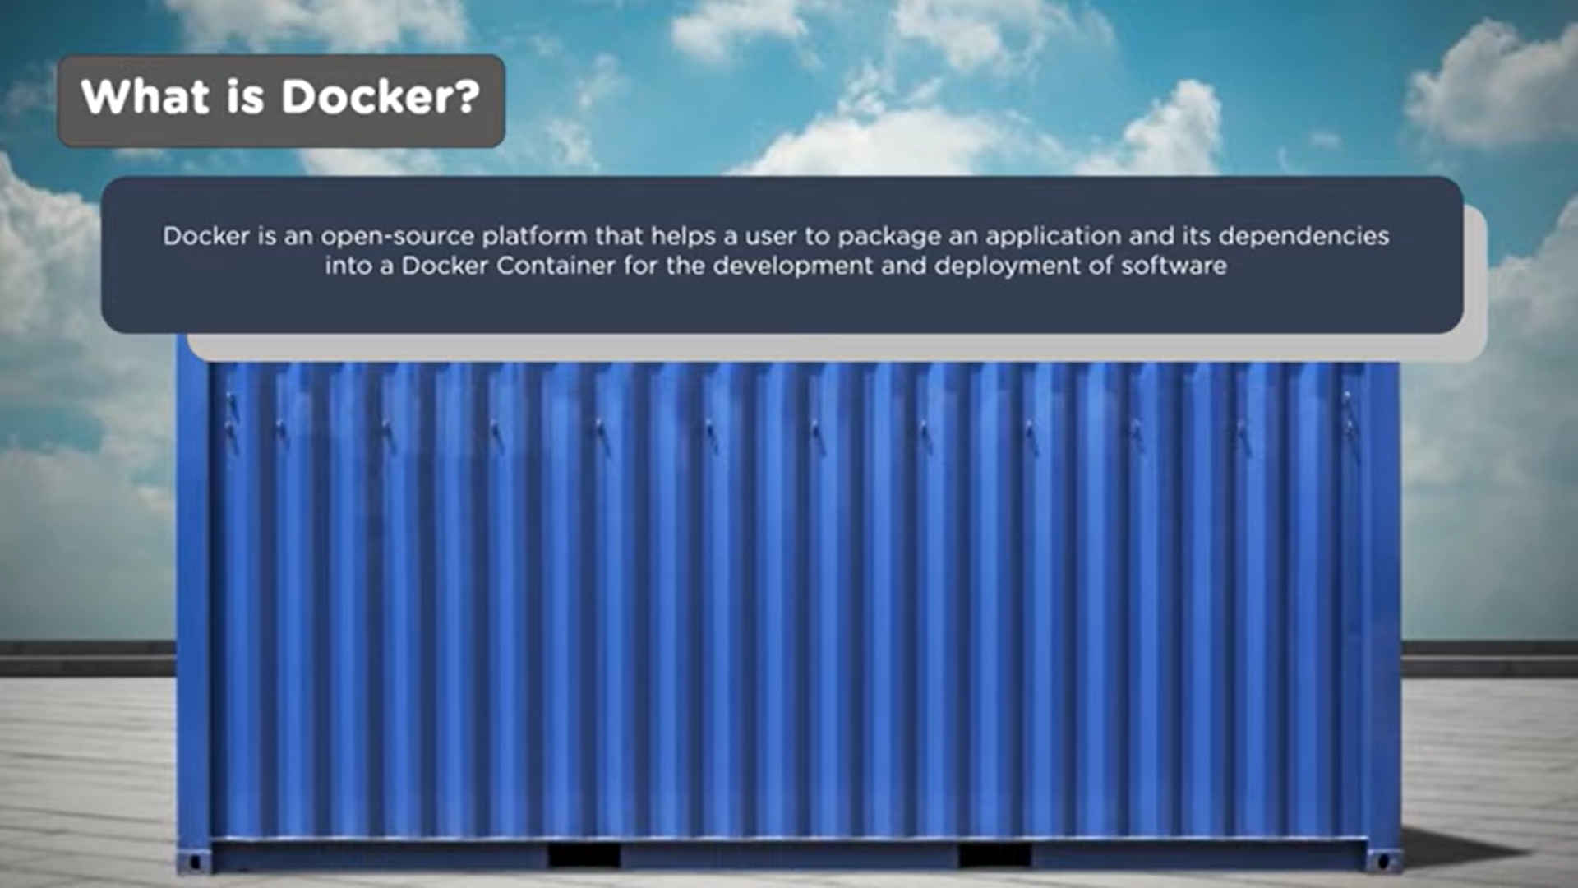
Docker

Slide 17
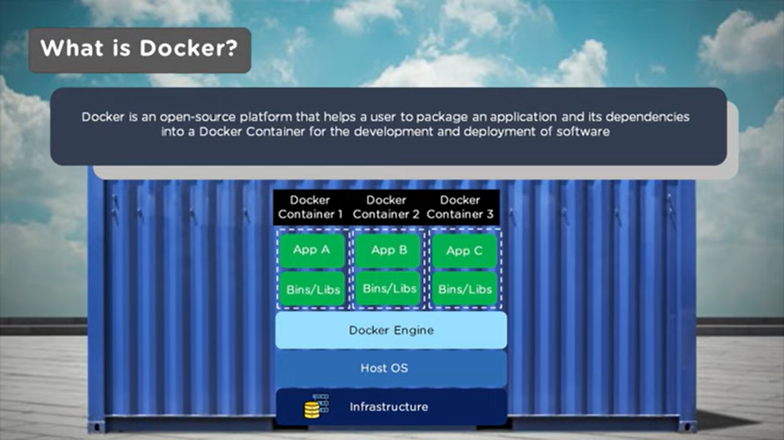
Docker

Slide 18
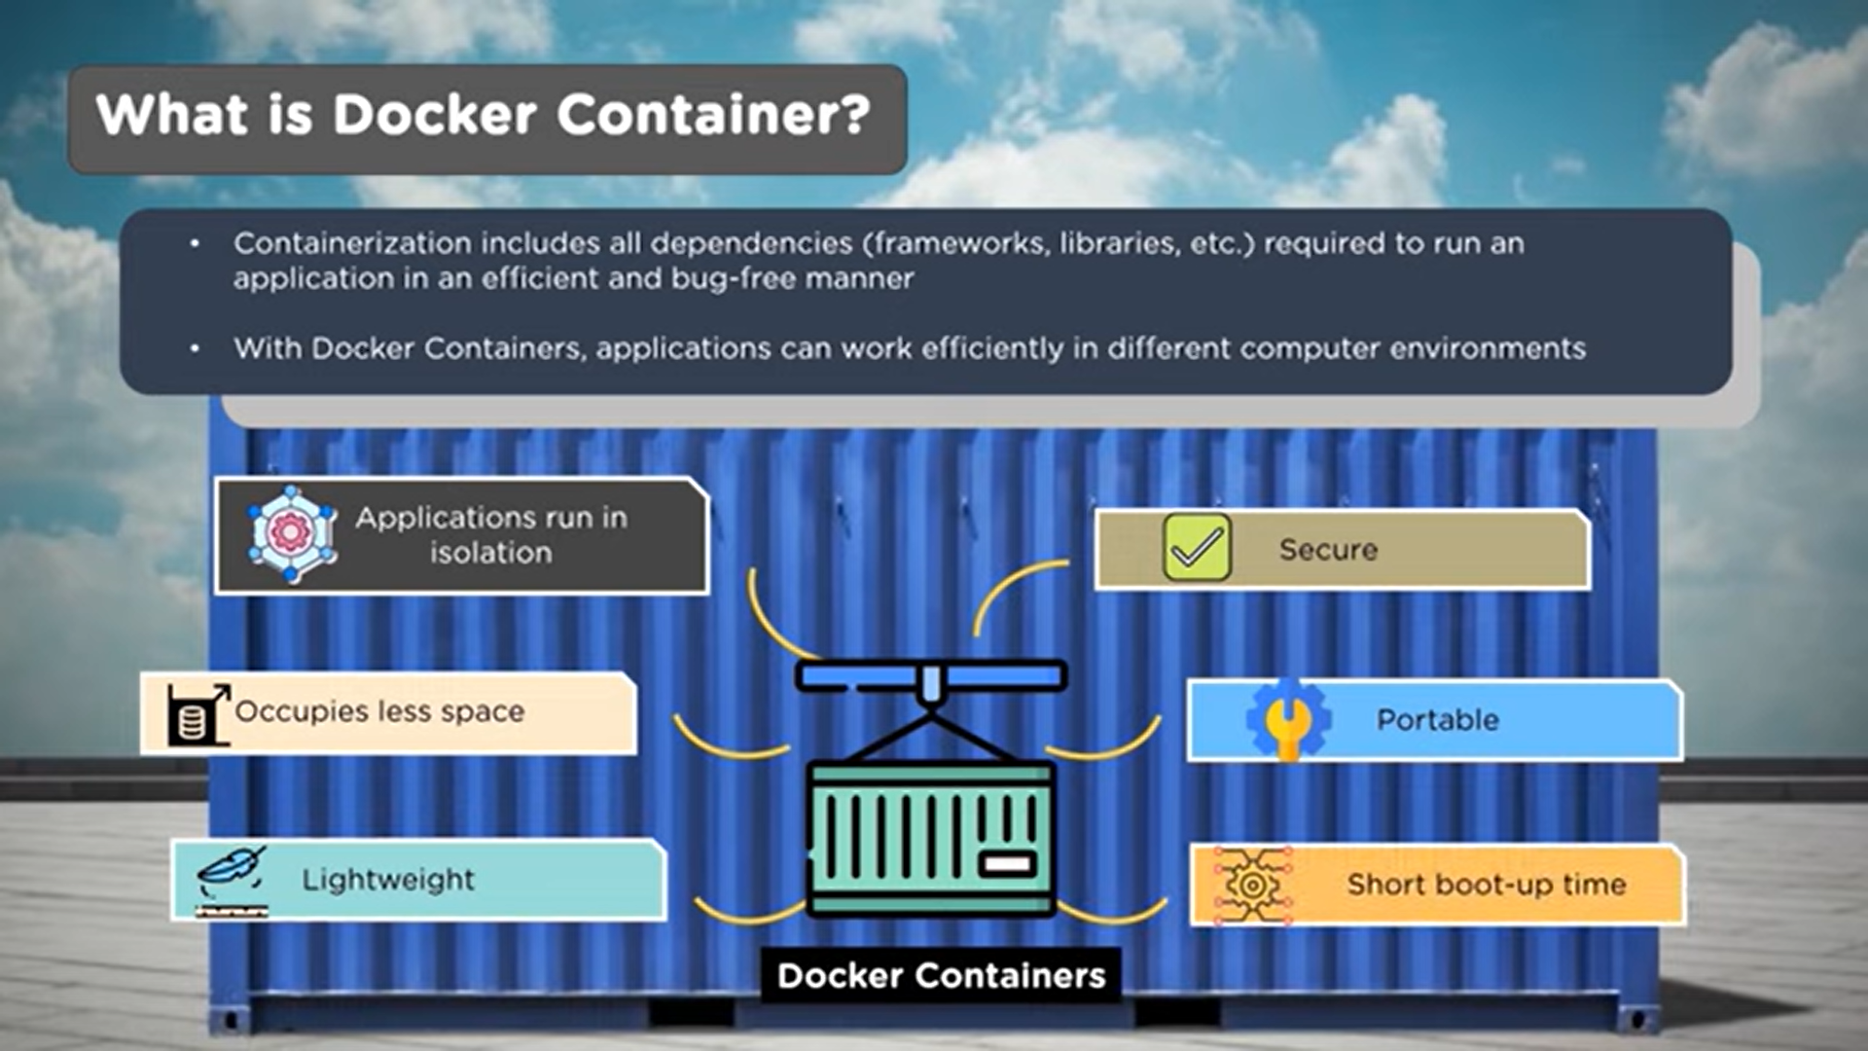
Docker

Slide 19
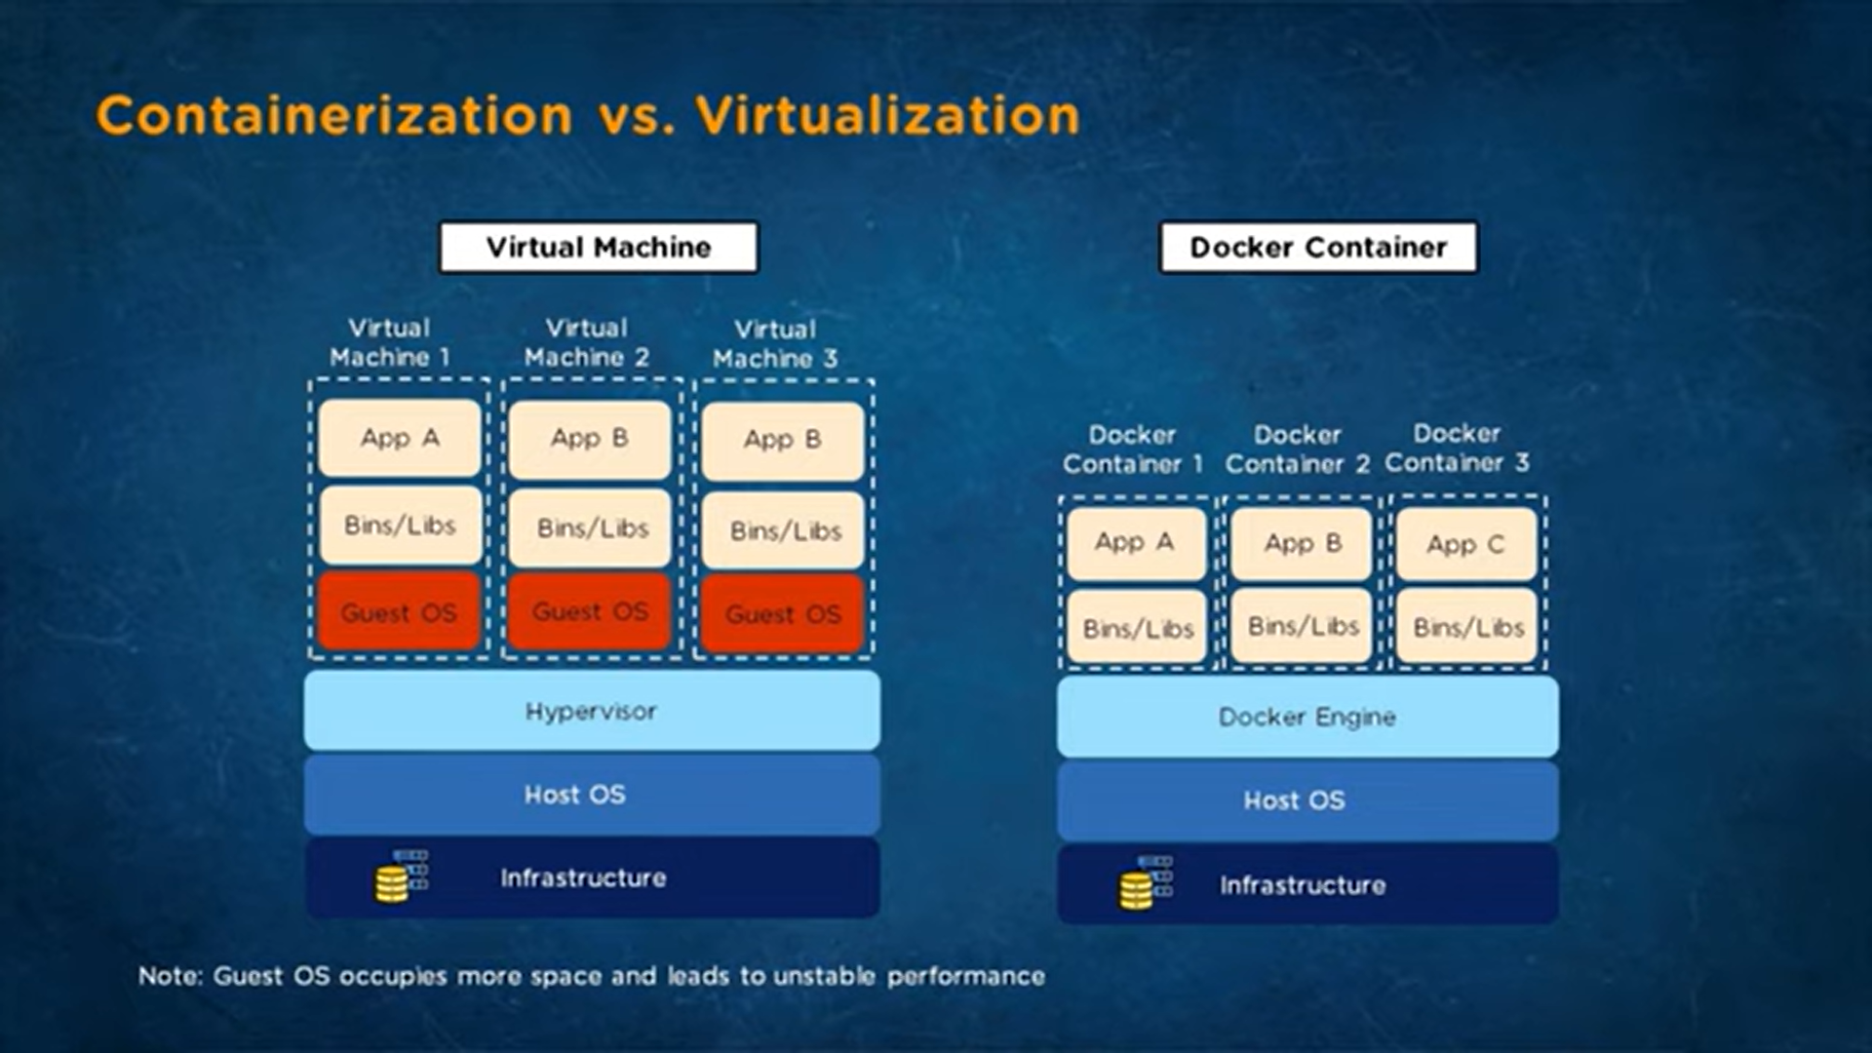
Docker

Slide 20
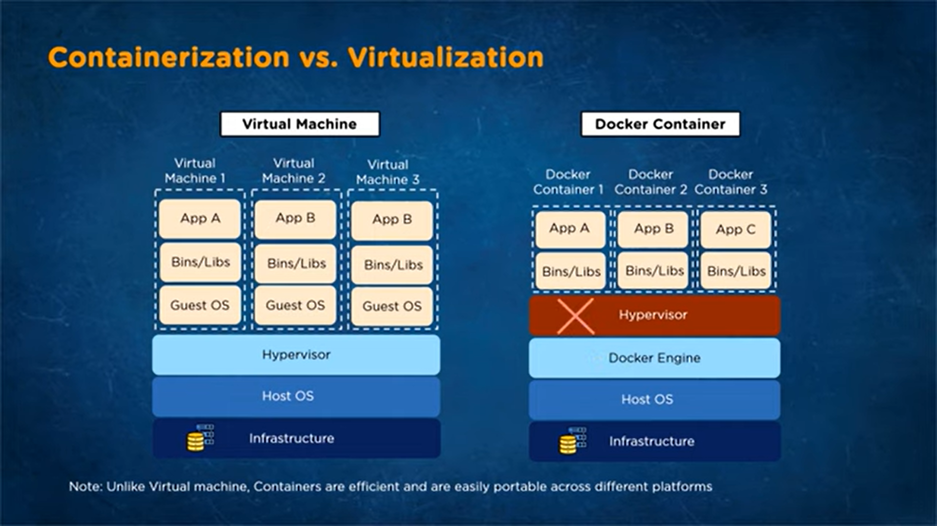
Docker

Slide 21
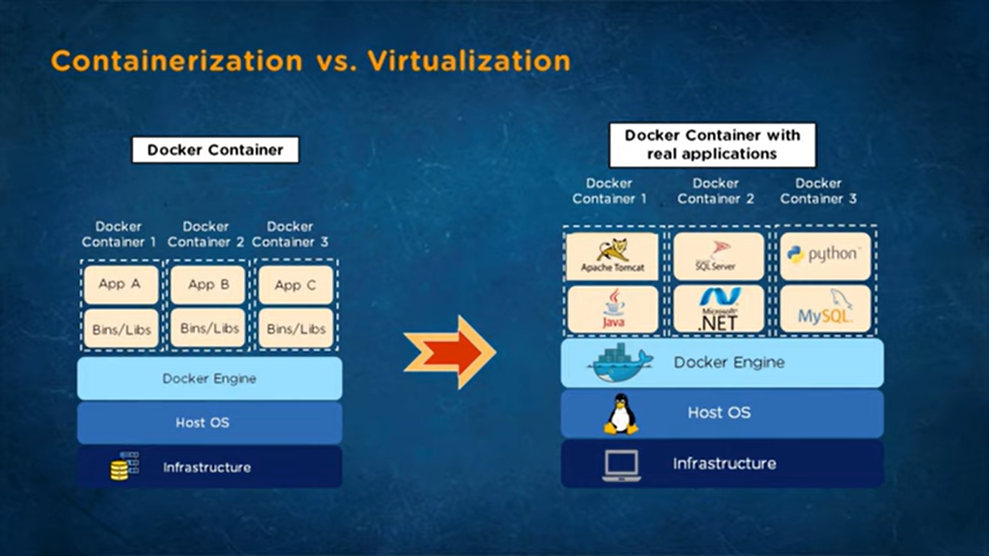
Docker

Slide 22
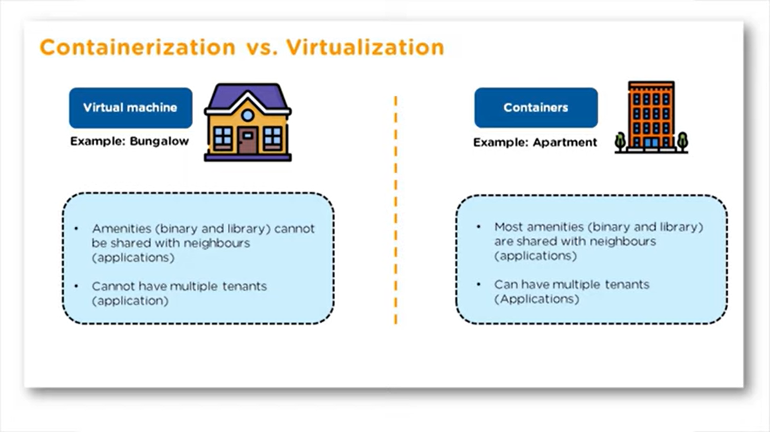
Docker

Slide 23
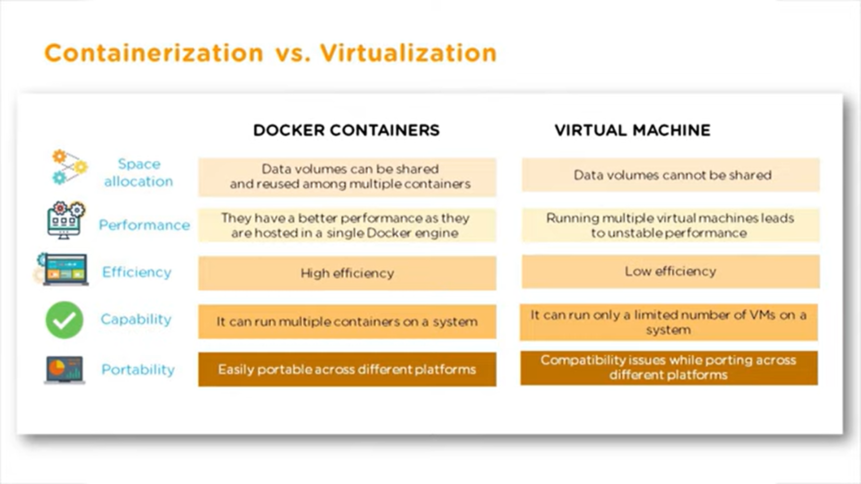
Docker

Slide 24
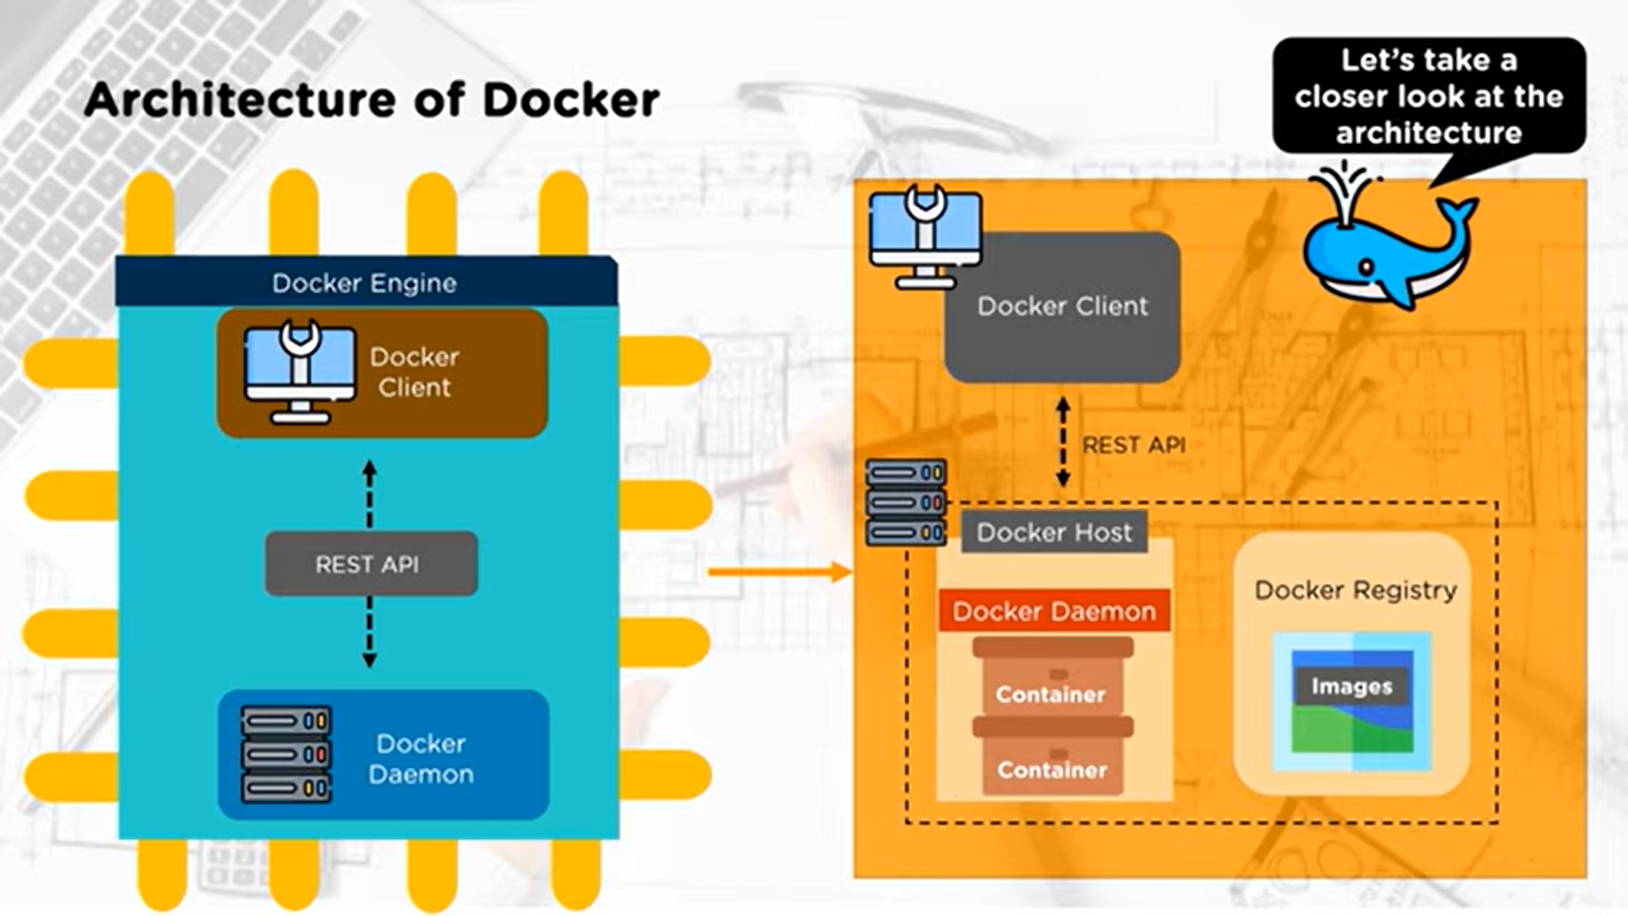
Docker

Slide 25
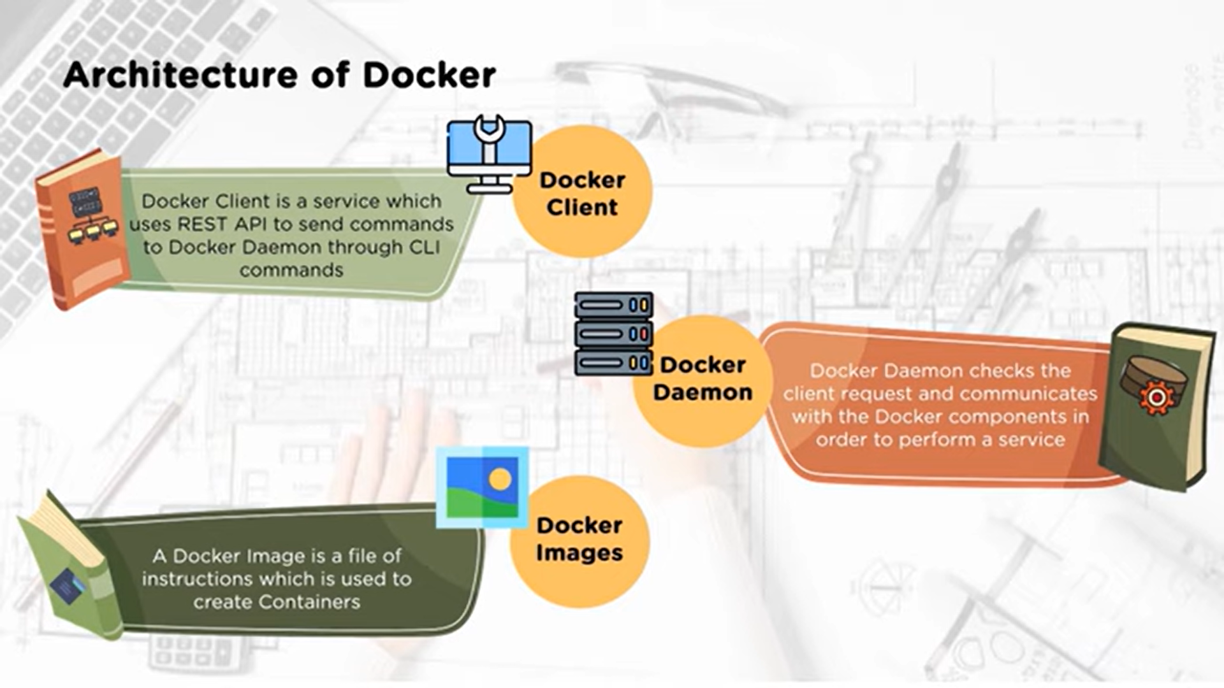
Docker

Slide 26
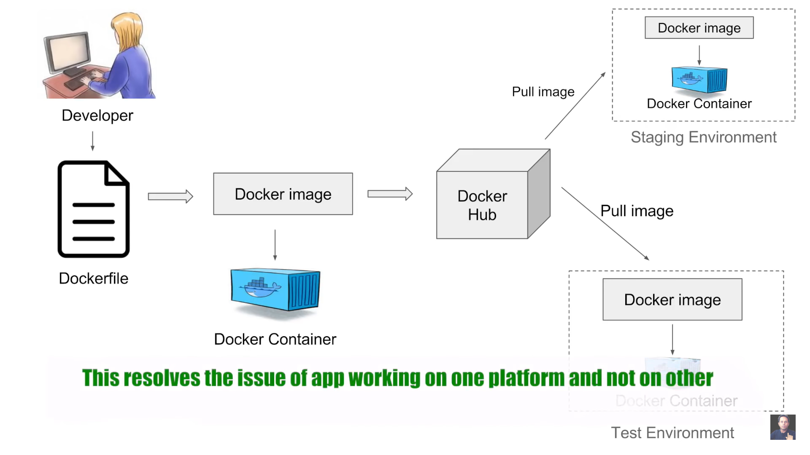
Docker

Slide 27
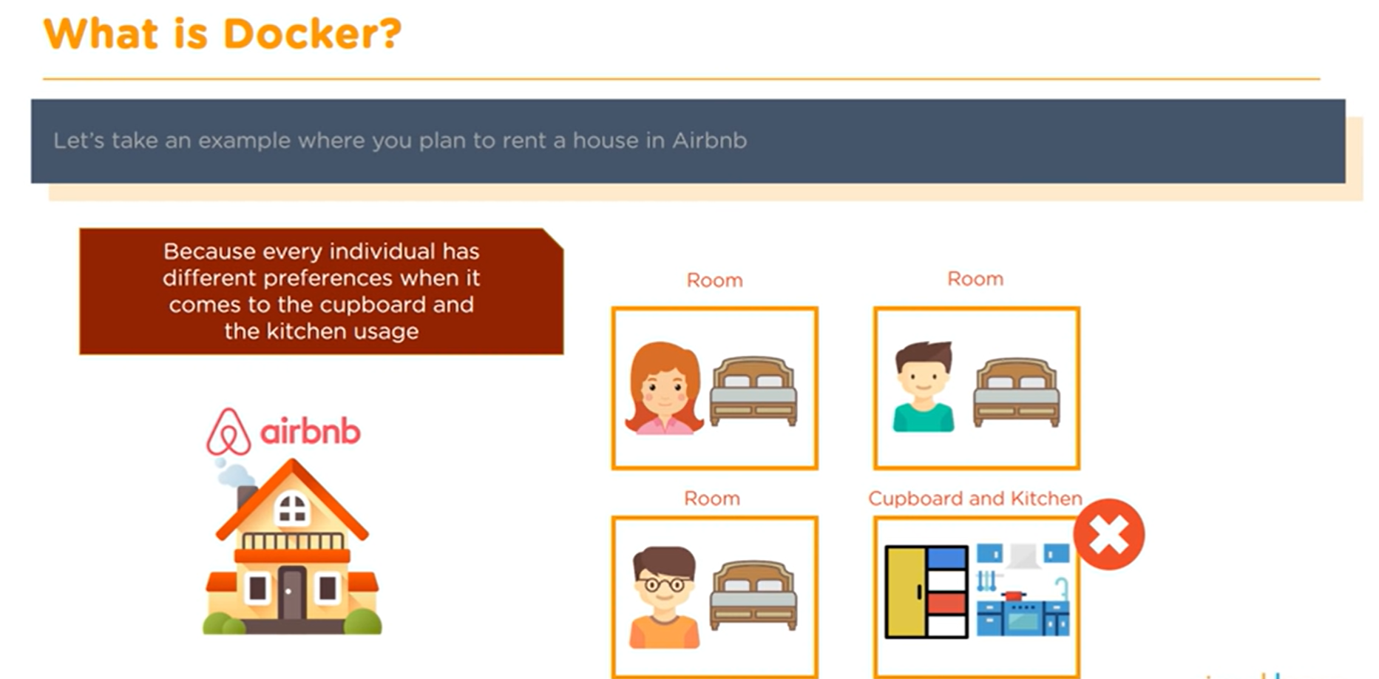
Docker

Slide 28
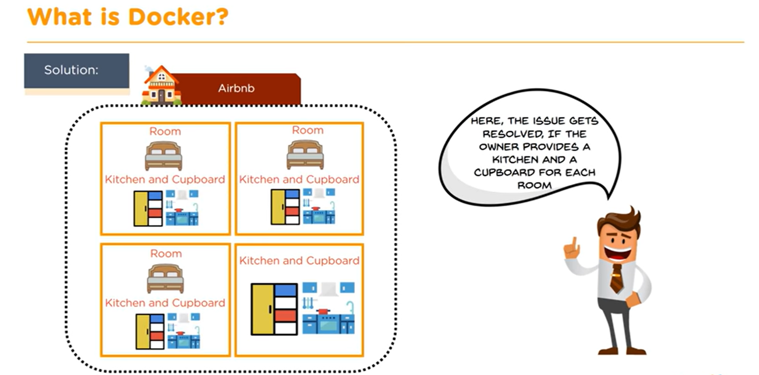
Docker

Slide 29
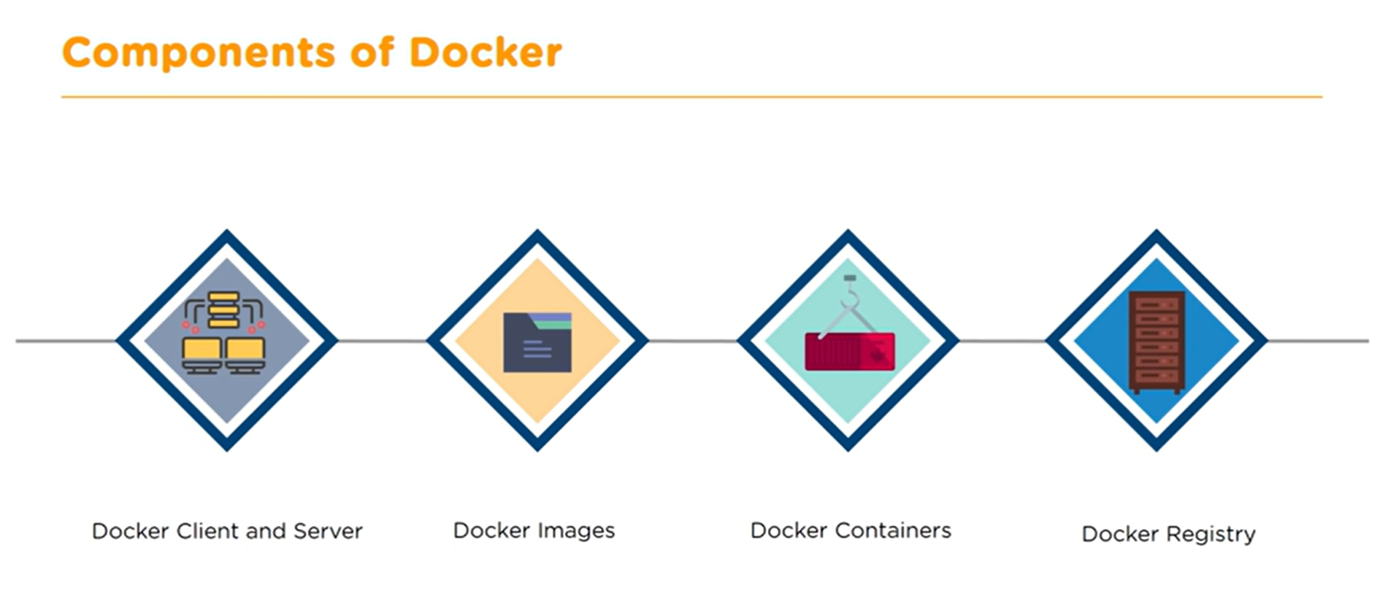
Docker

Slide 30
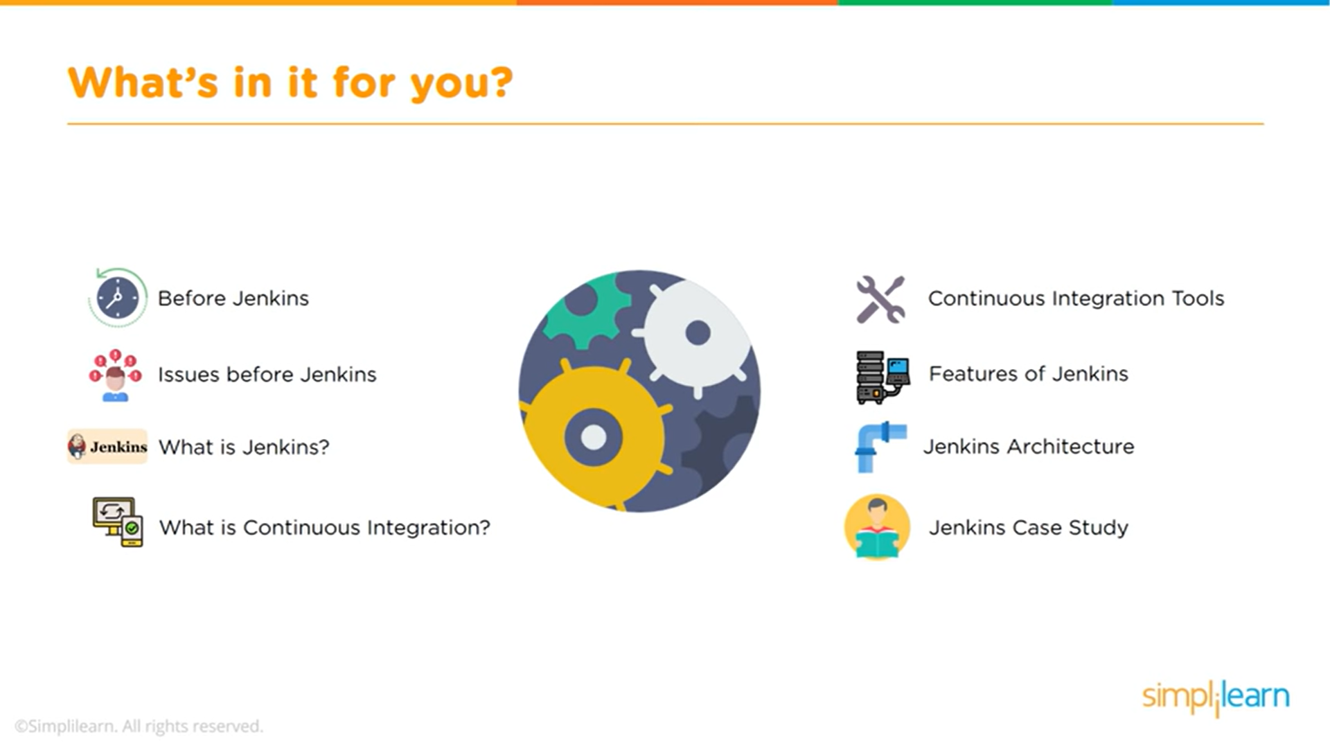
Jenkins

Slide 31
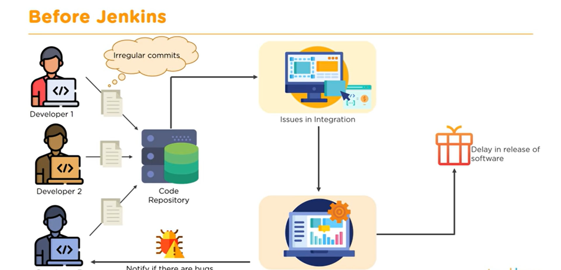
Jenkins

Slide 32
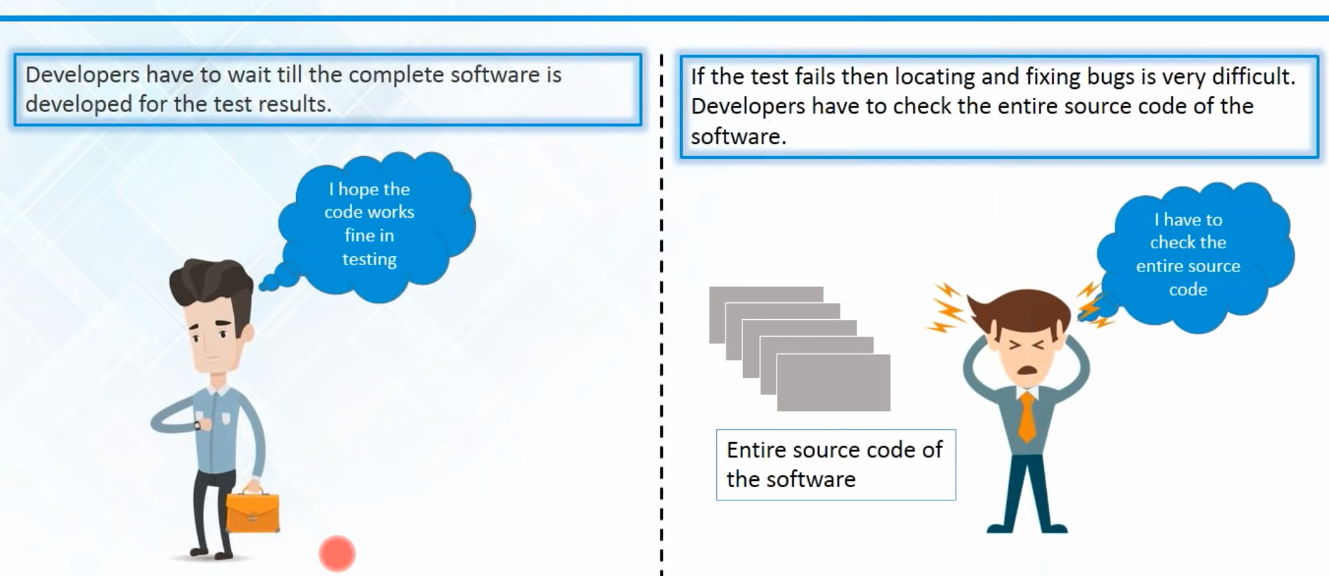
Jenkins

Slide 33
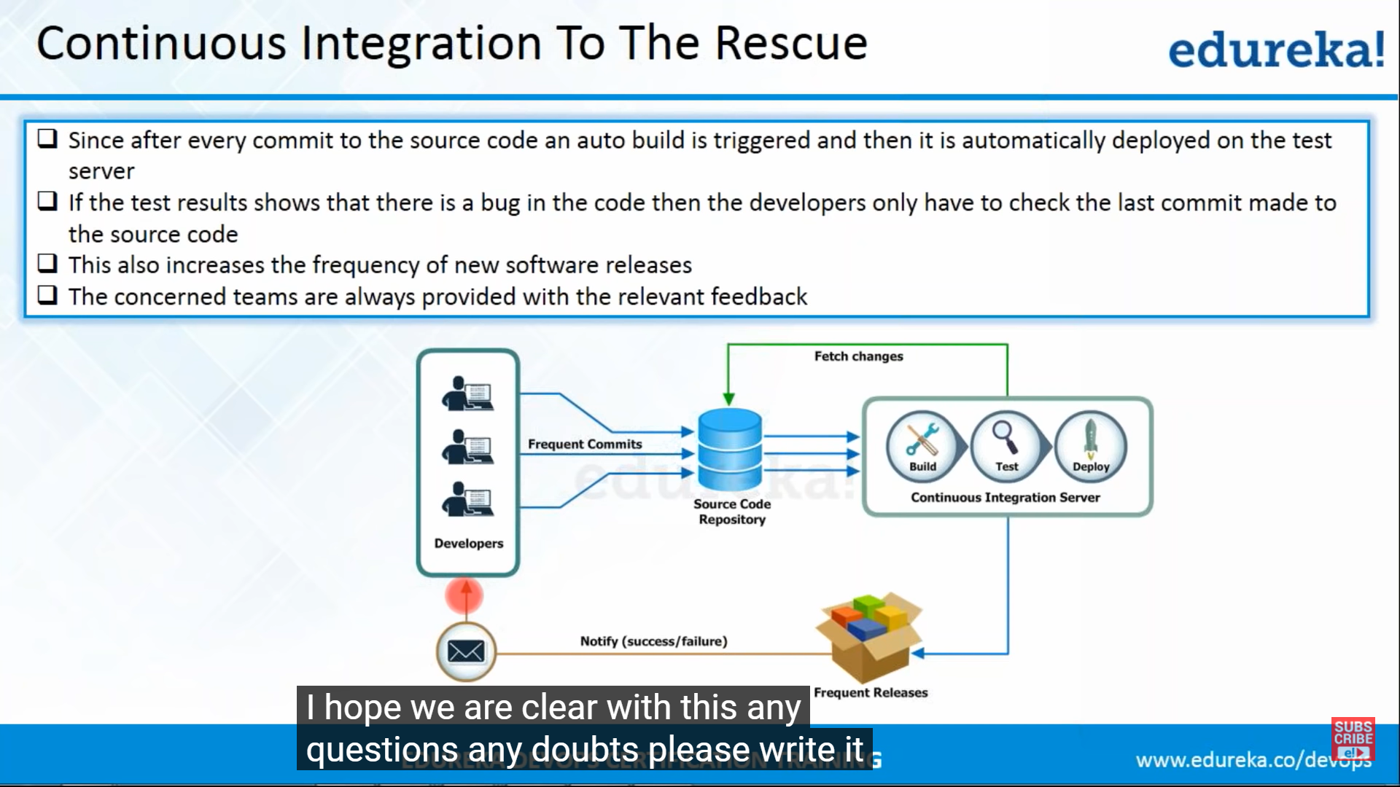
Jenkins

Slide 34
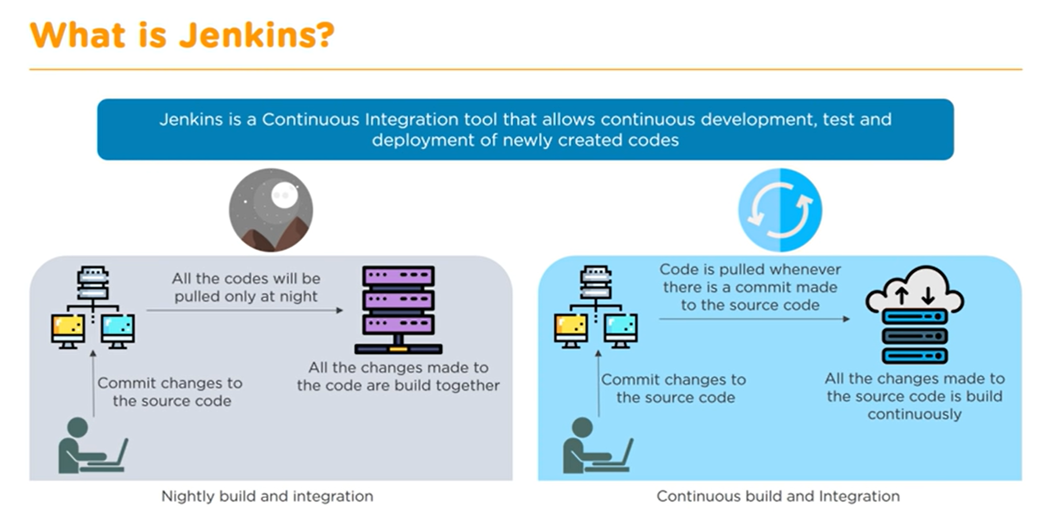
Jenkins

Slide 35
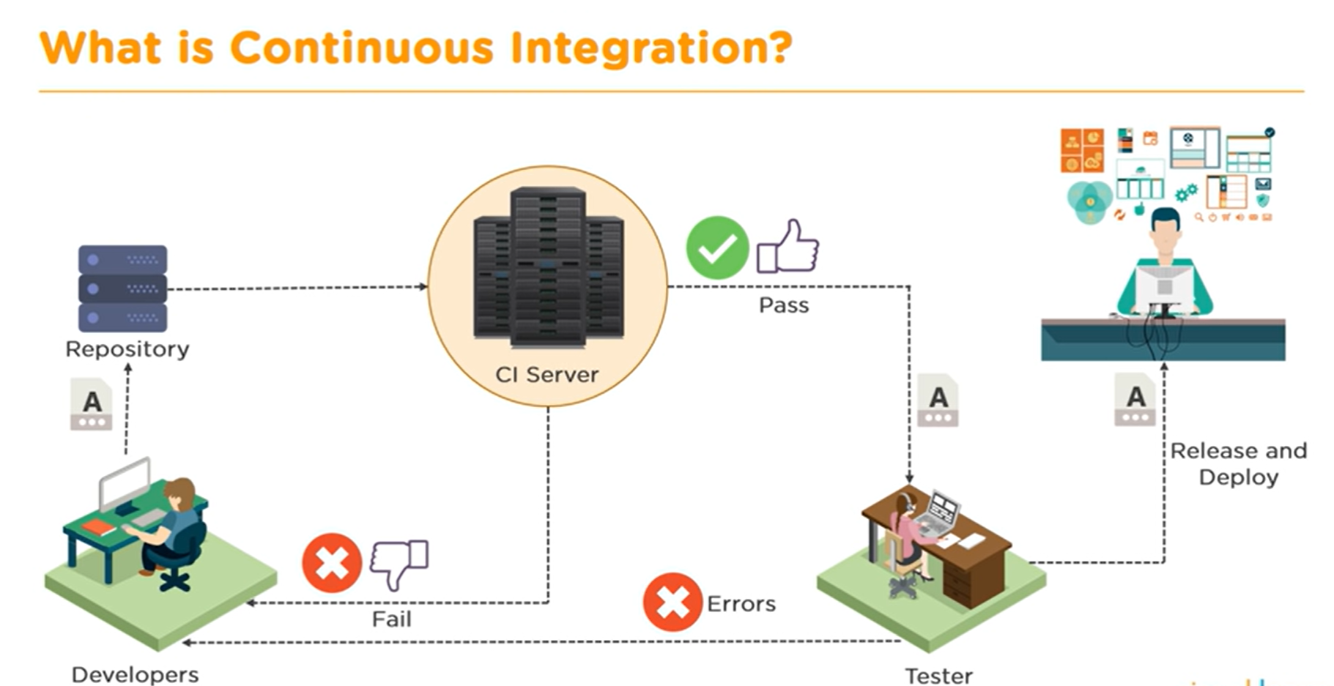
Jenkins

Slide 36
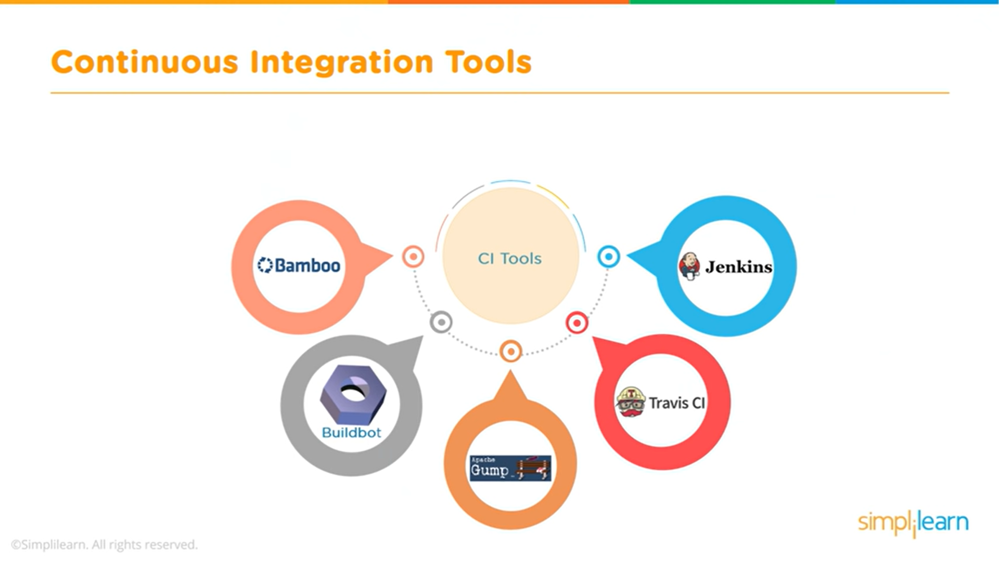
Jenkins

Slide 37
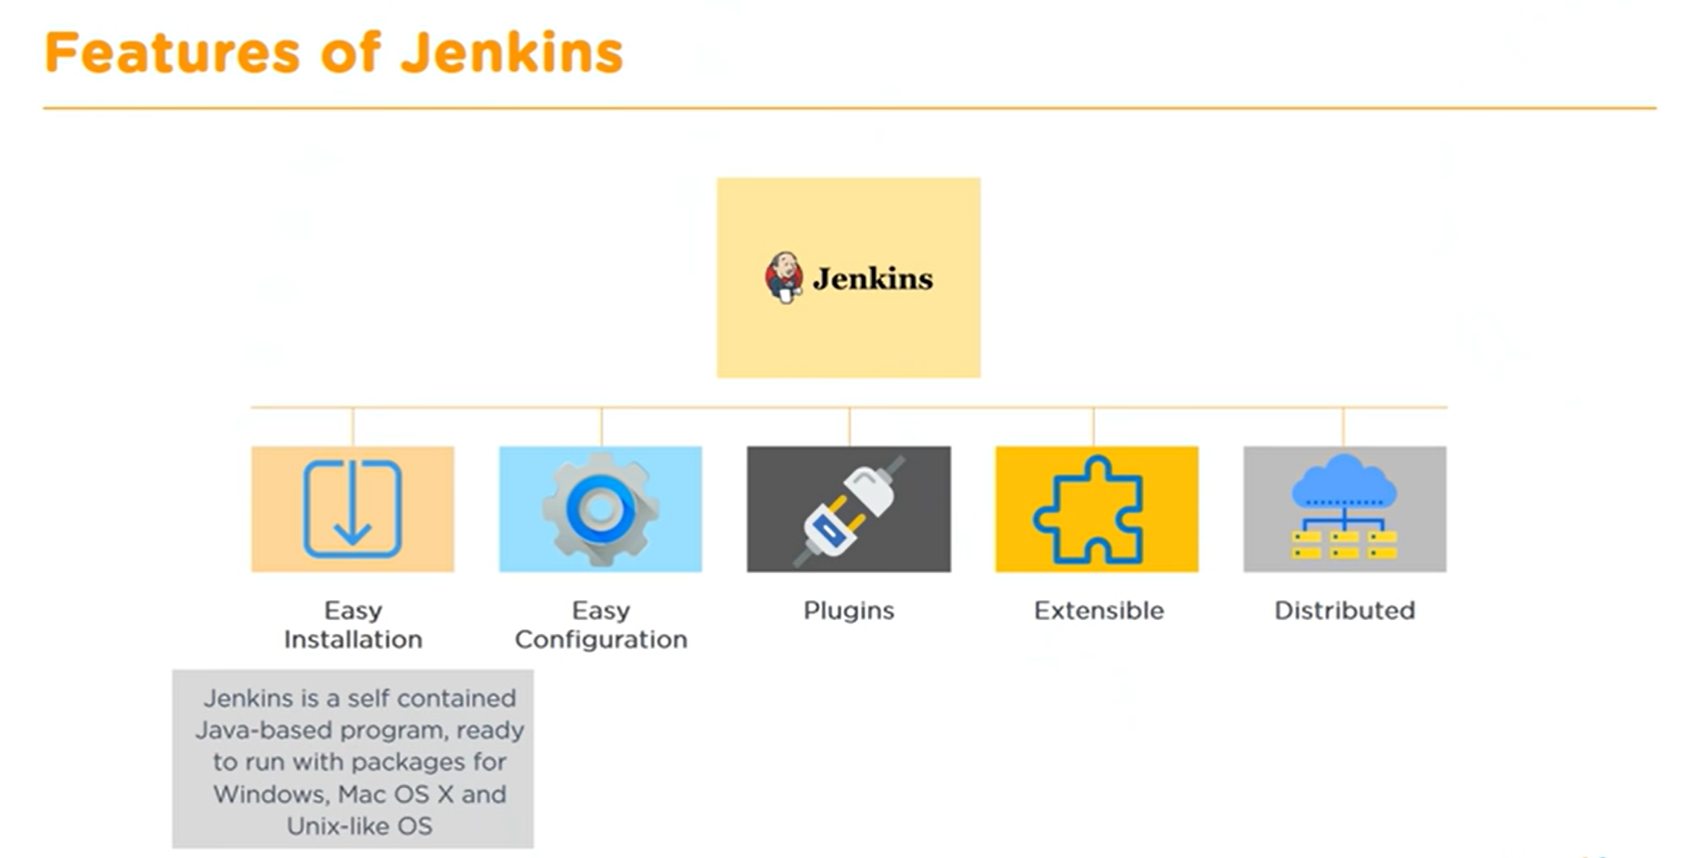
Jenkins

Slide 38
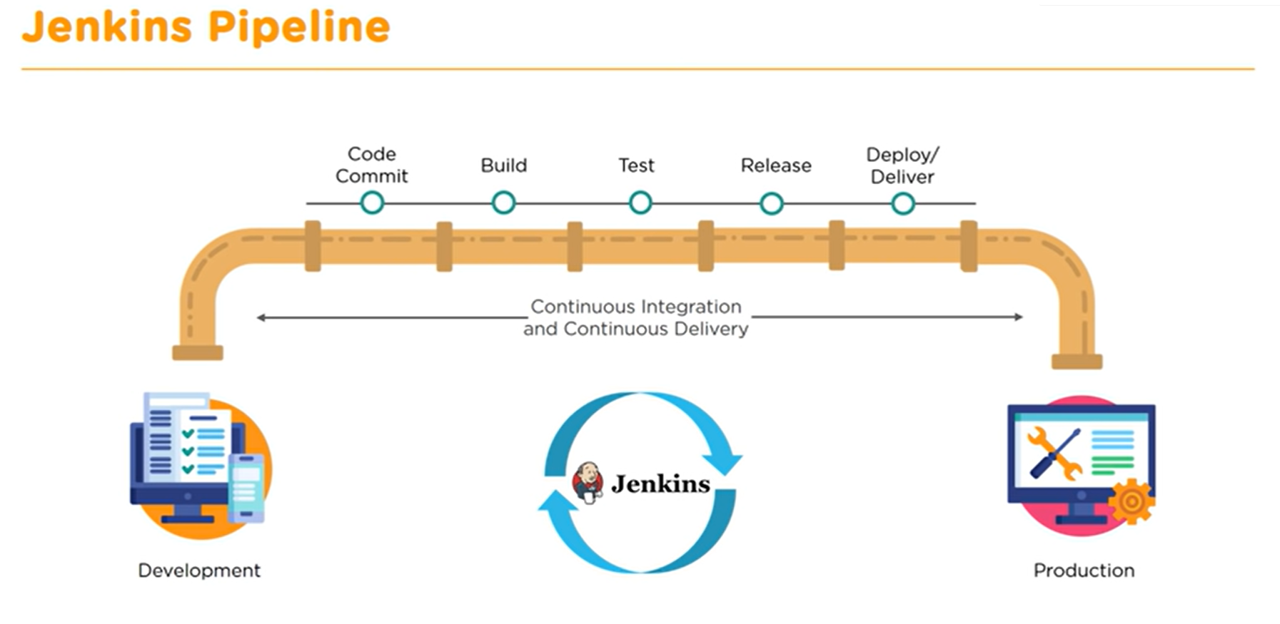
Jenkins

Slide 39
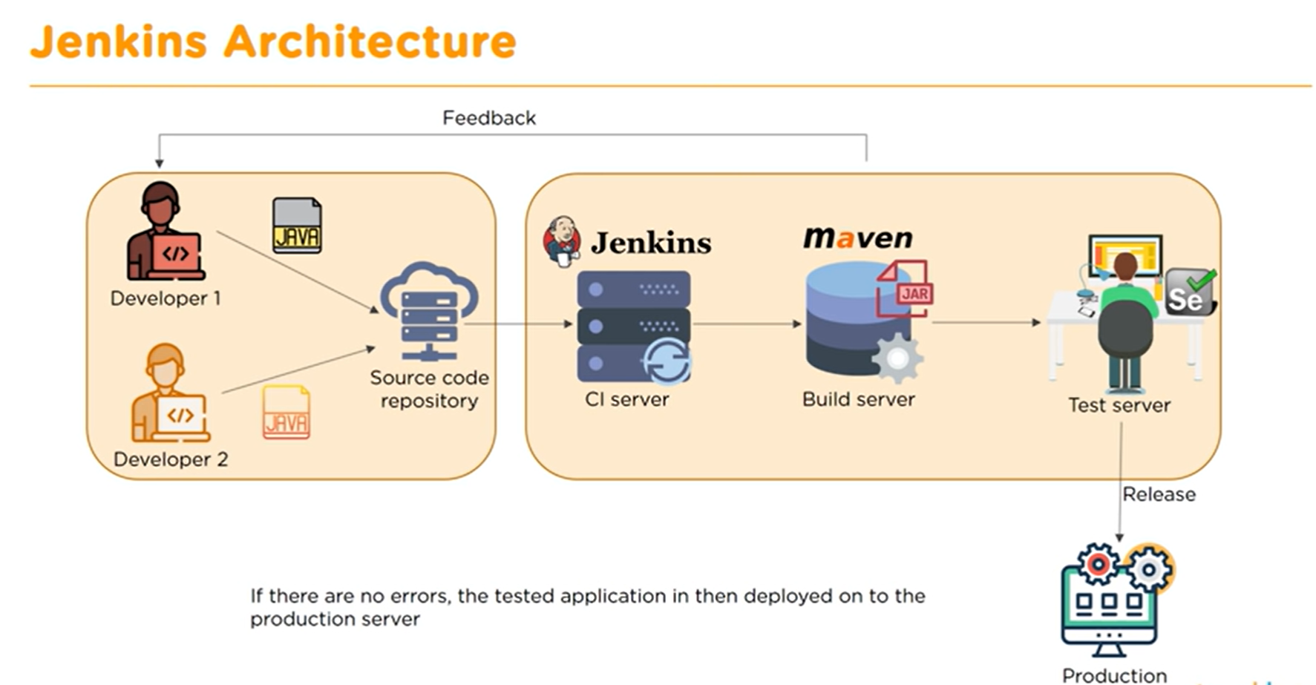
Jenkins

Slide 40
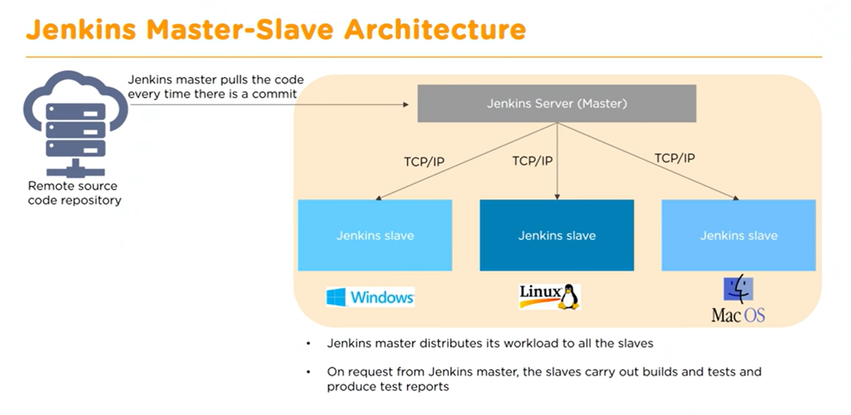
Jenkins

Slide 41
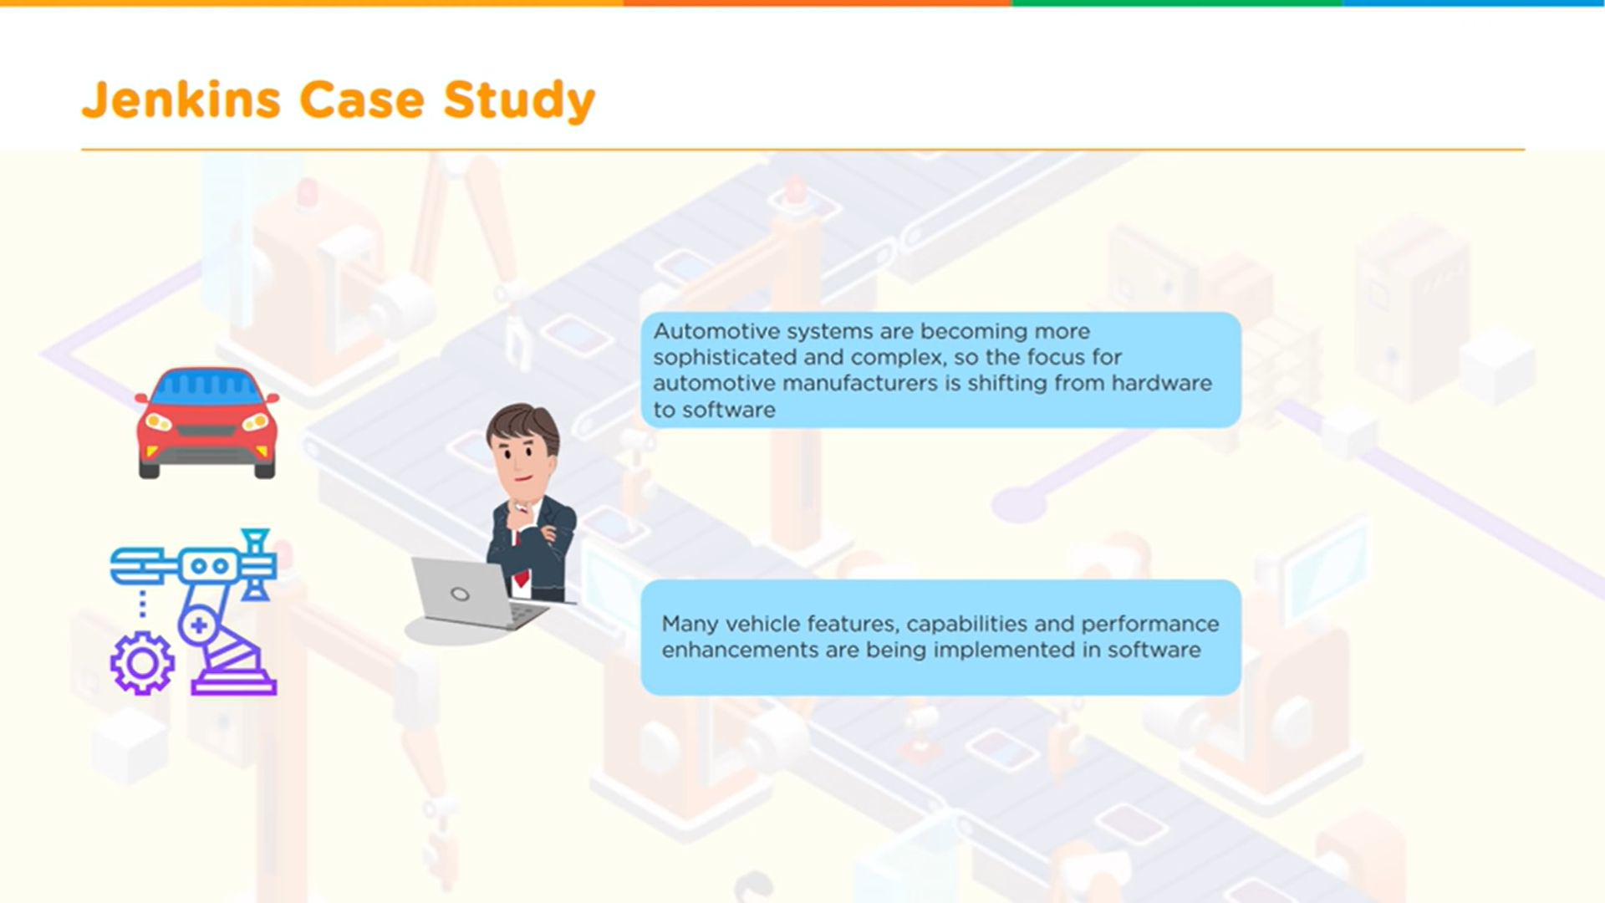
Jenkins

Slide 42
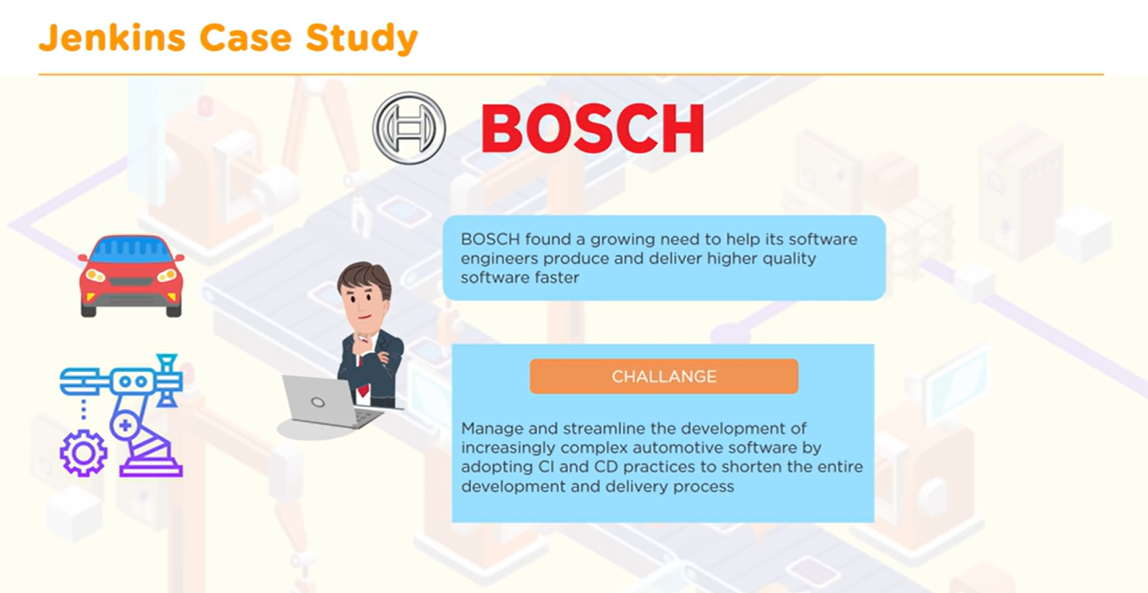
Jenkins

Slide 43
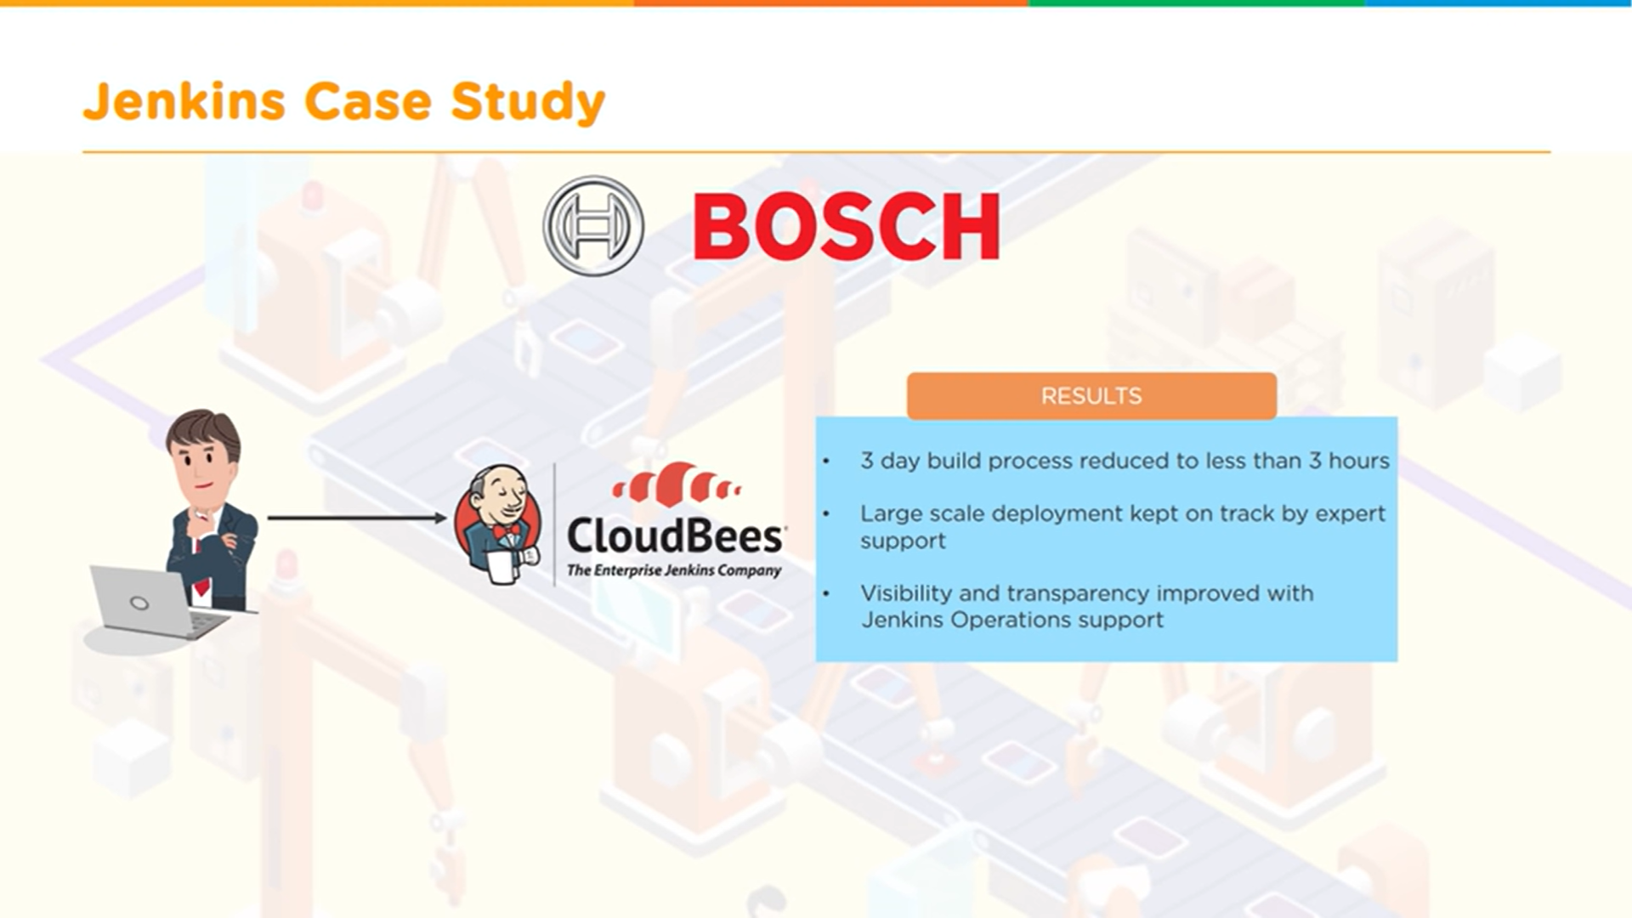
Jenkins

Slide 44
YAML is a popular programming language because it is designed to be easy to read and understand. It can also be used in conjunction with other programming languages. Because of its flexibility and accessibility
YAML
YAML is a human-readable data serialization language that is often used for writing configuration files. Depending on whom you ask, YAML stands for yet another markup language or YAML ain't markup language (a recursive acronym), which emphasizes that YAML is for data, not documents.
Many developers consider it easier to learn than JSON because it's written using natural language. YAML is a superset of JSON. It was developed around the same time to handle more kinds of data and offer a more complex but still readable syntax.

Slide 45
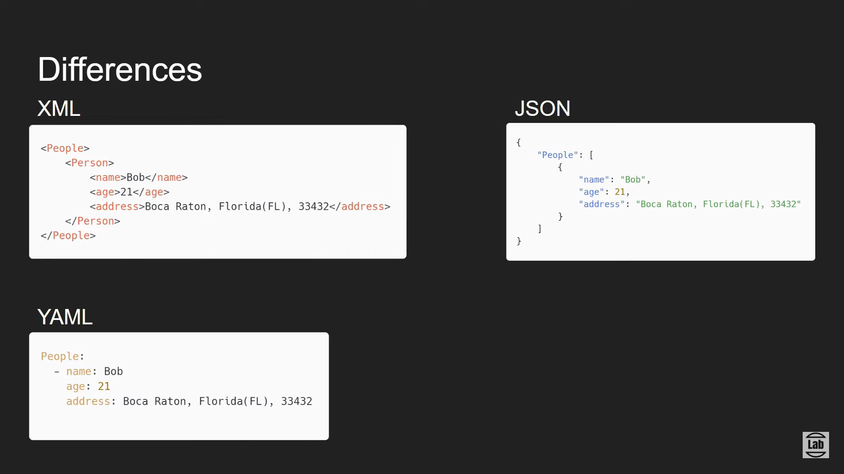
YAML

Slide 46
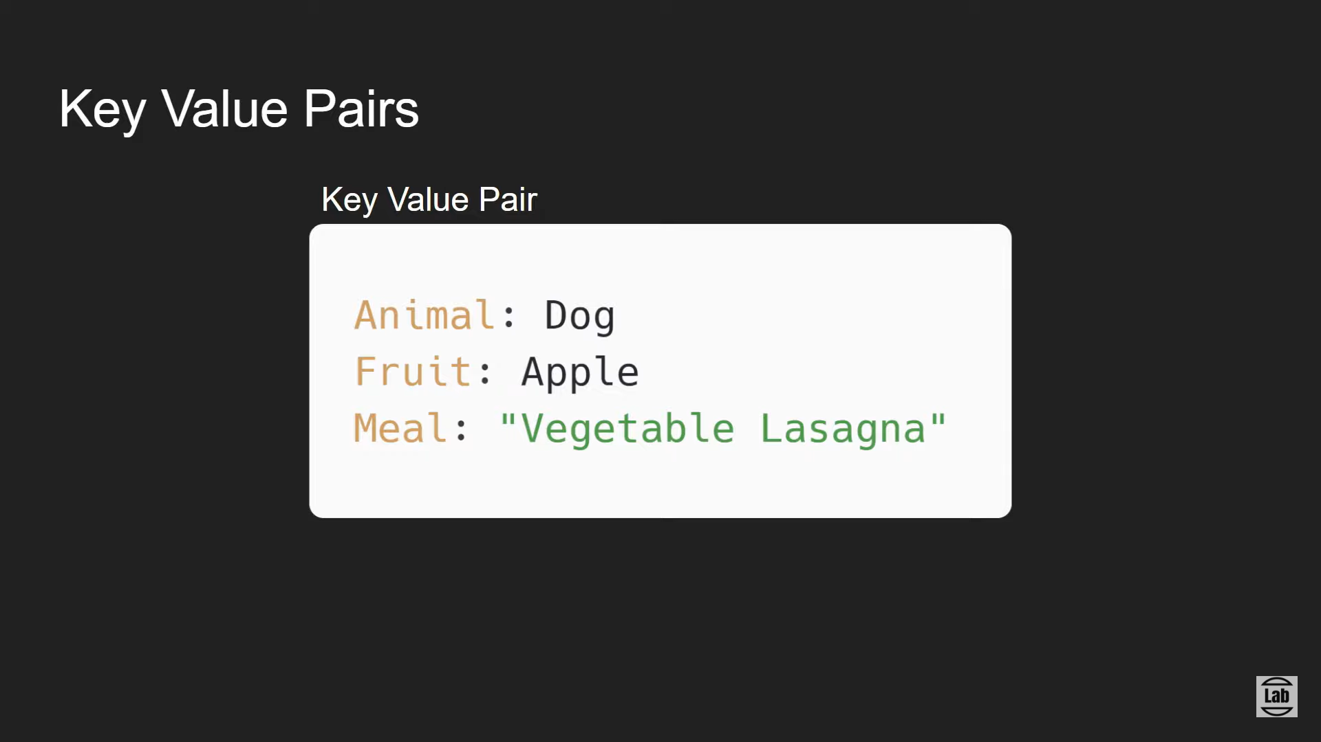
YAML

Slide 47
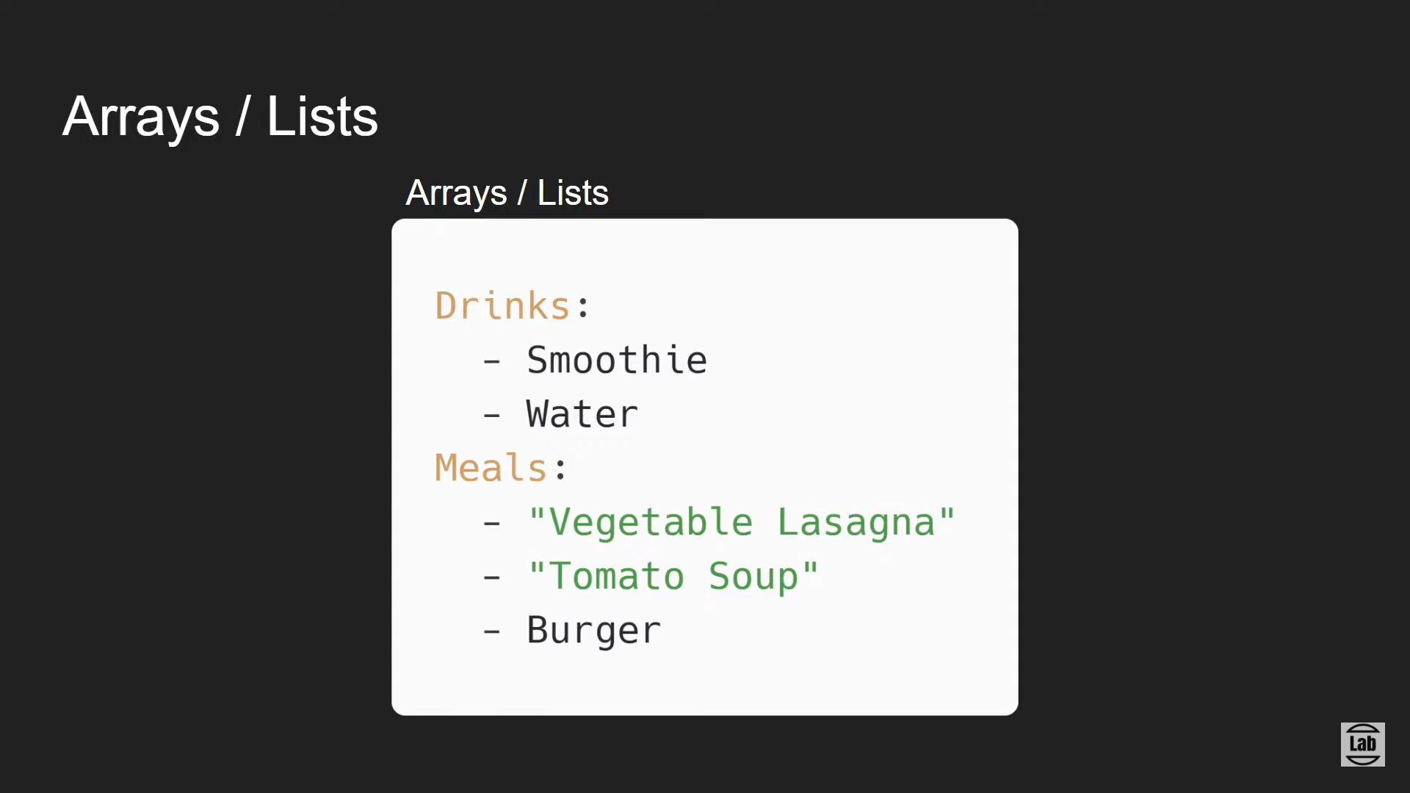
YAML

Slide 48
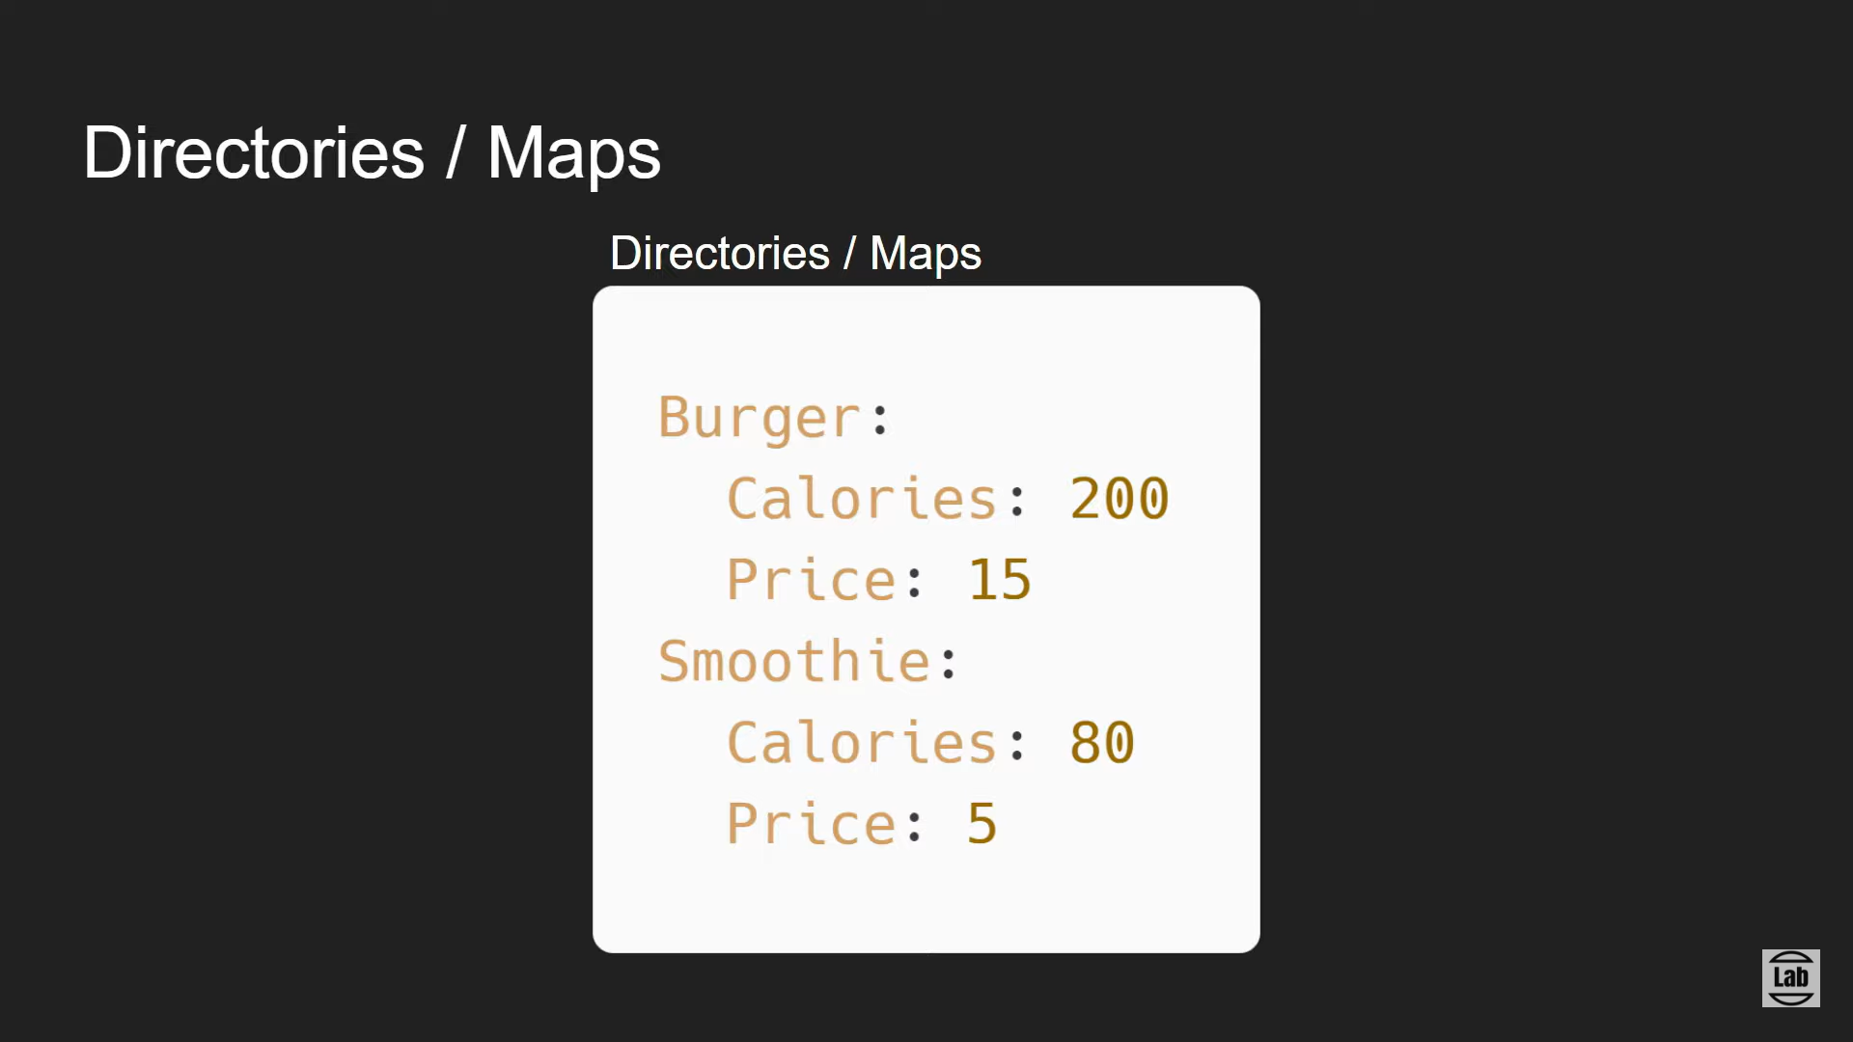
YAML

Slide 49
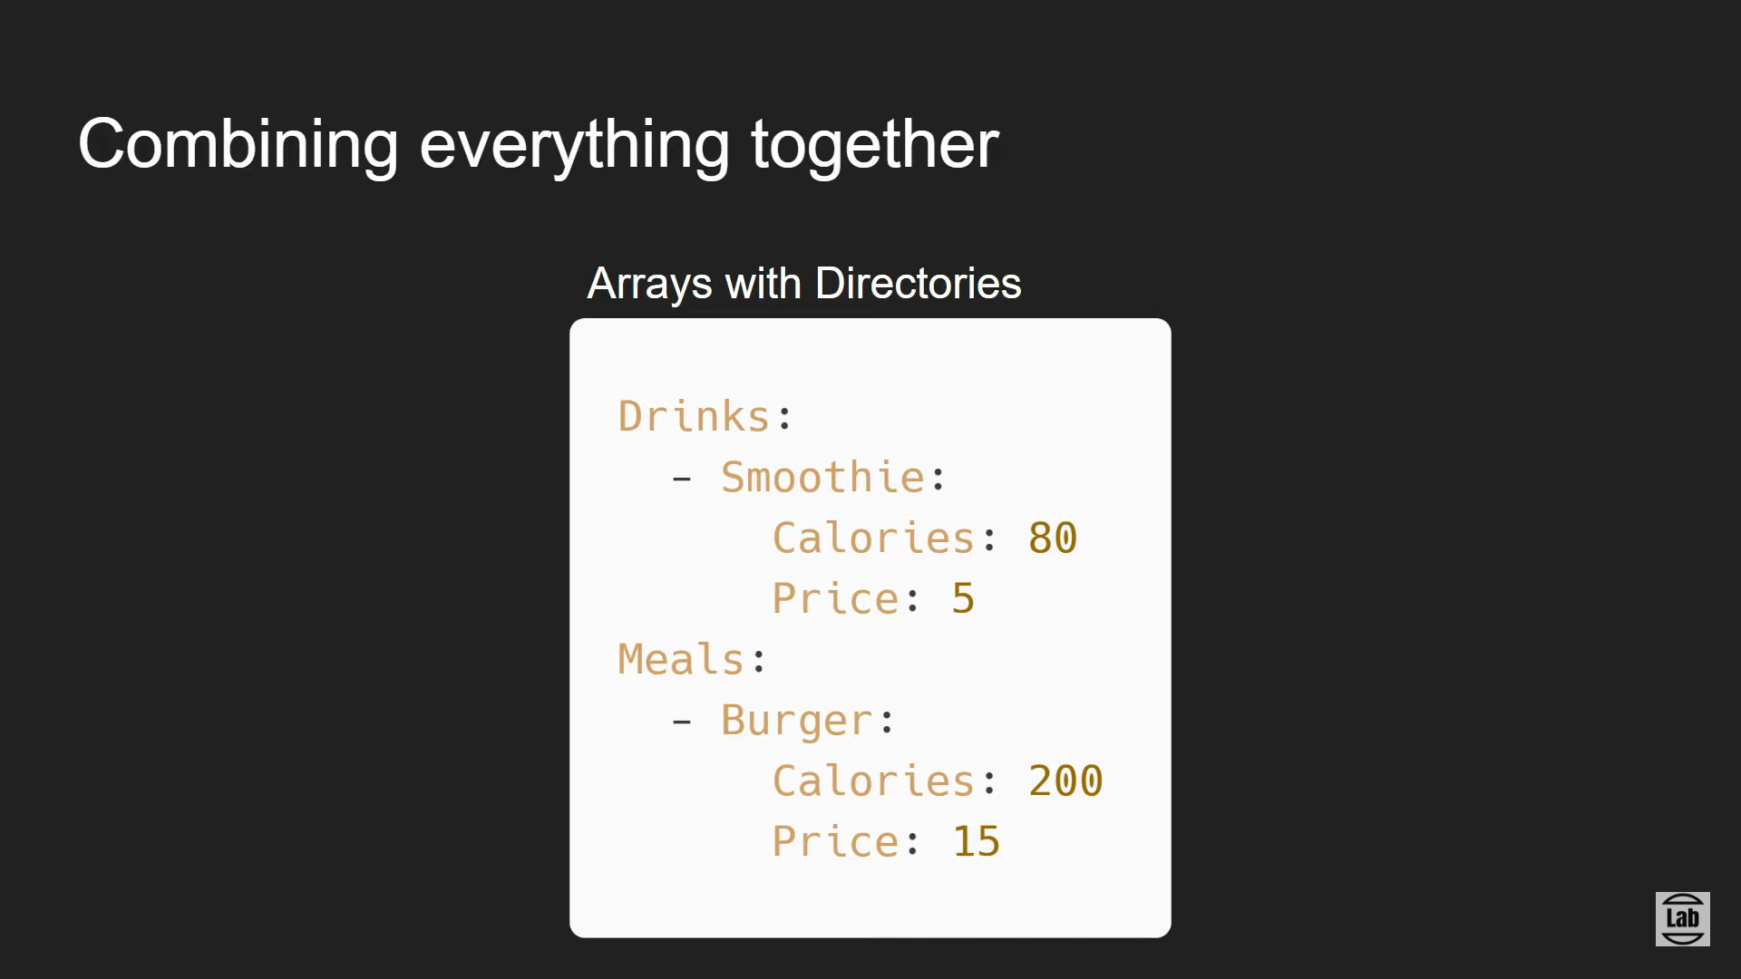
YAML

Slide 50
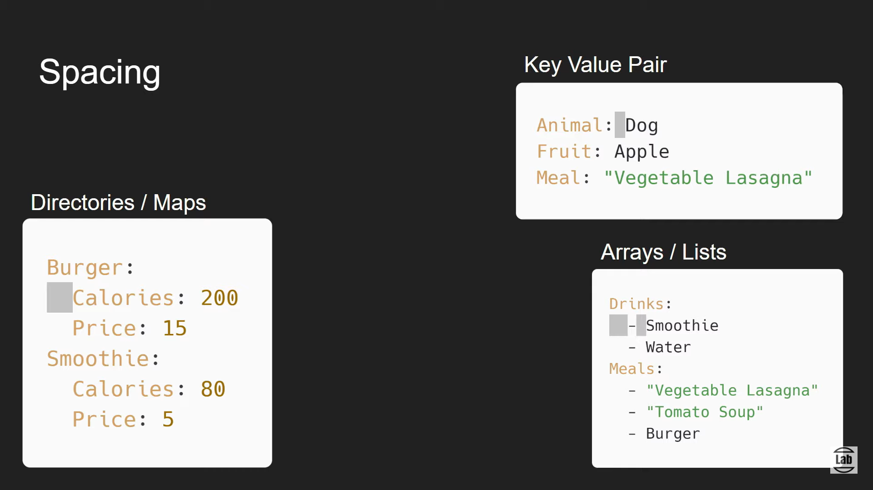
YAML

Slide 51
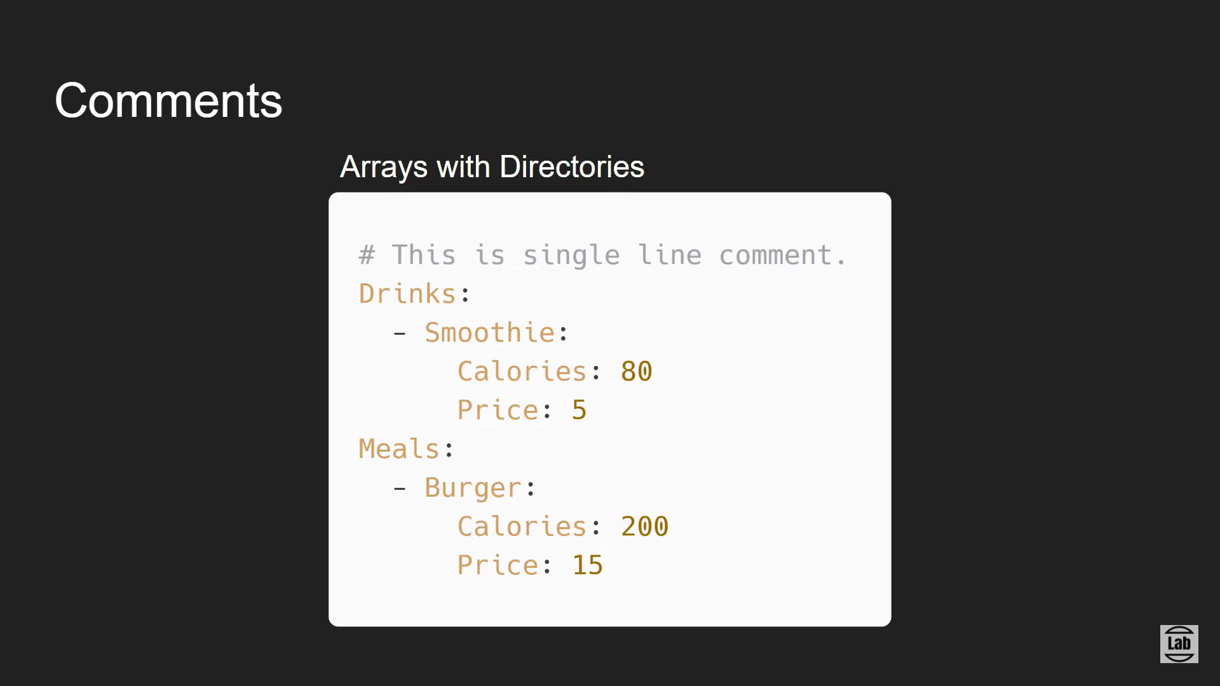
YAML

Slide 52
Kubernetes
Kubernetes is an open-source container orchestration system for automating software deployment, scaling, and management. Originally designed by Google, the project is now maintained by the Cloud Native Computing Foundation. The name Kubernetes originates from Greek, meaning 'helmsman' or 'pilot'.
Kubernetes, also known as K8s, is an open-source system for automating deployment, scaling, and management of containerized applications
Kubernetes automates operational tasks of container management and includes built-in commands for deploying applications, rolling out changes to your applications, scaling your applications up and down to fit changing needs, monitoring your applications, and more—making it easier to manage applications.
Kubernetes is the most popular container orchestration platform and has become an essential tool for DevOps teams. Application teams can now deploy containerized applications to Kubernetes clusters, which can run either on-premises or in a cloud environment.
Kubernetes creates and manages containers on the cloud-based server systems. Kubernetes helps DevOps teams to reduce the burden of infrastructure by letting containers operate on different machines/environments without breakdowns

Slide 53
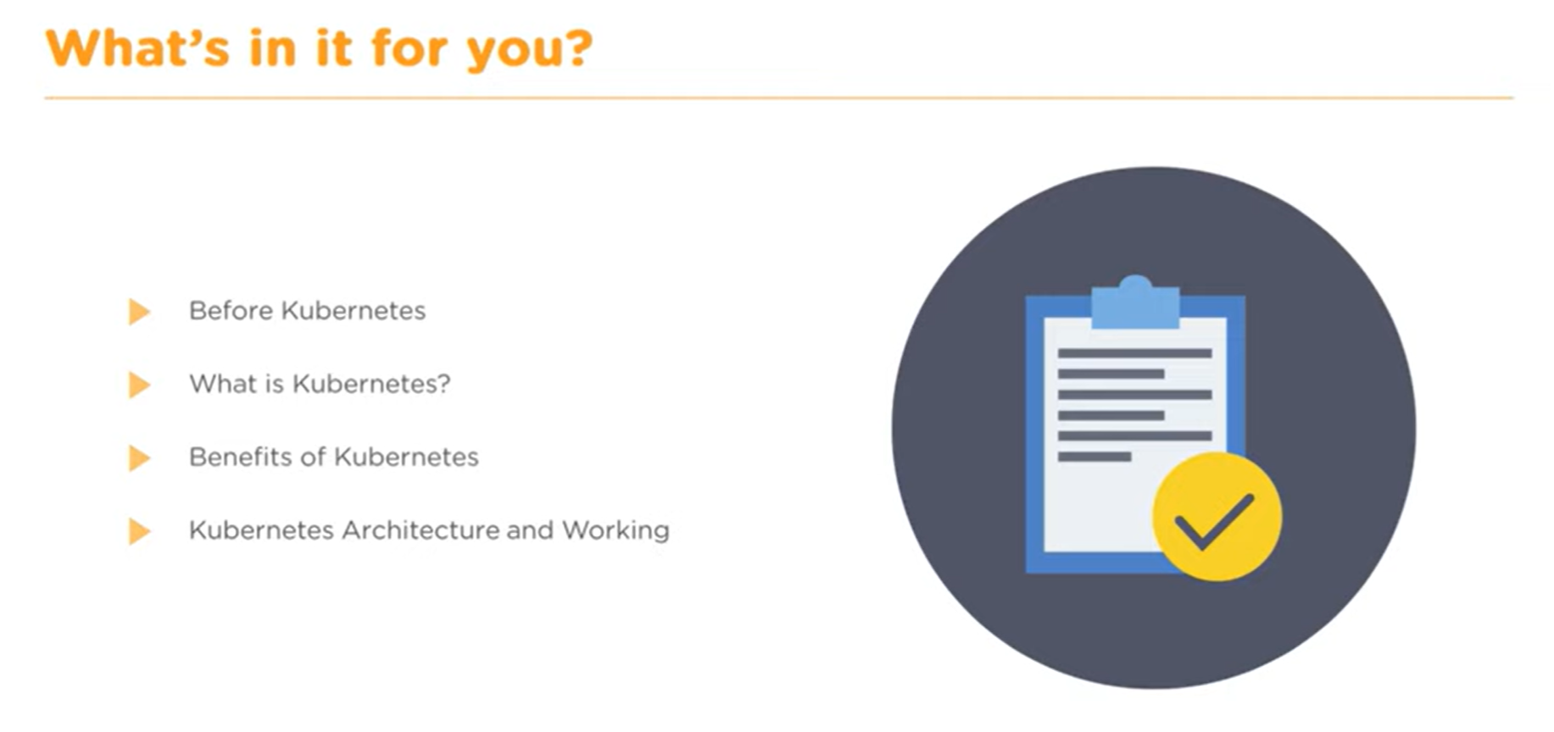
Kubernetes

Slide 54
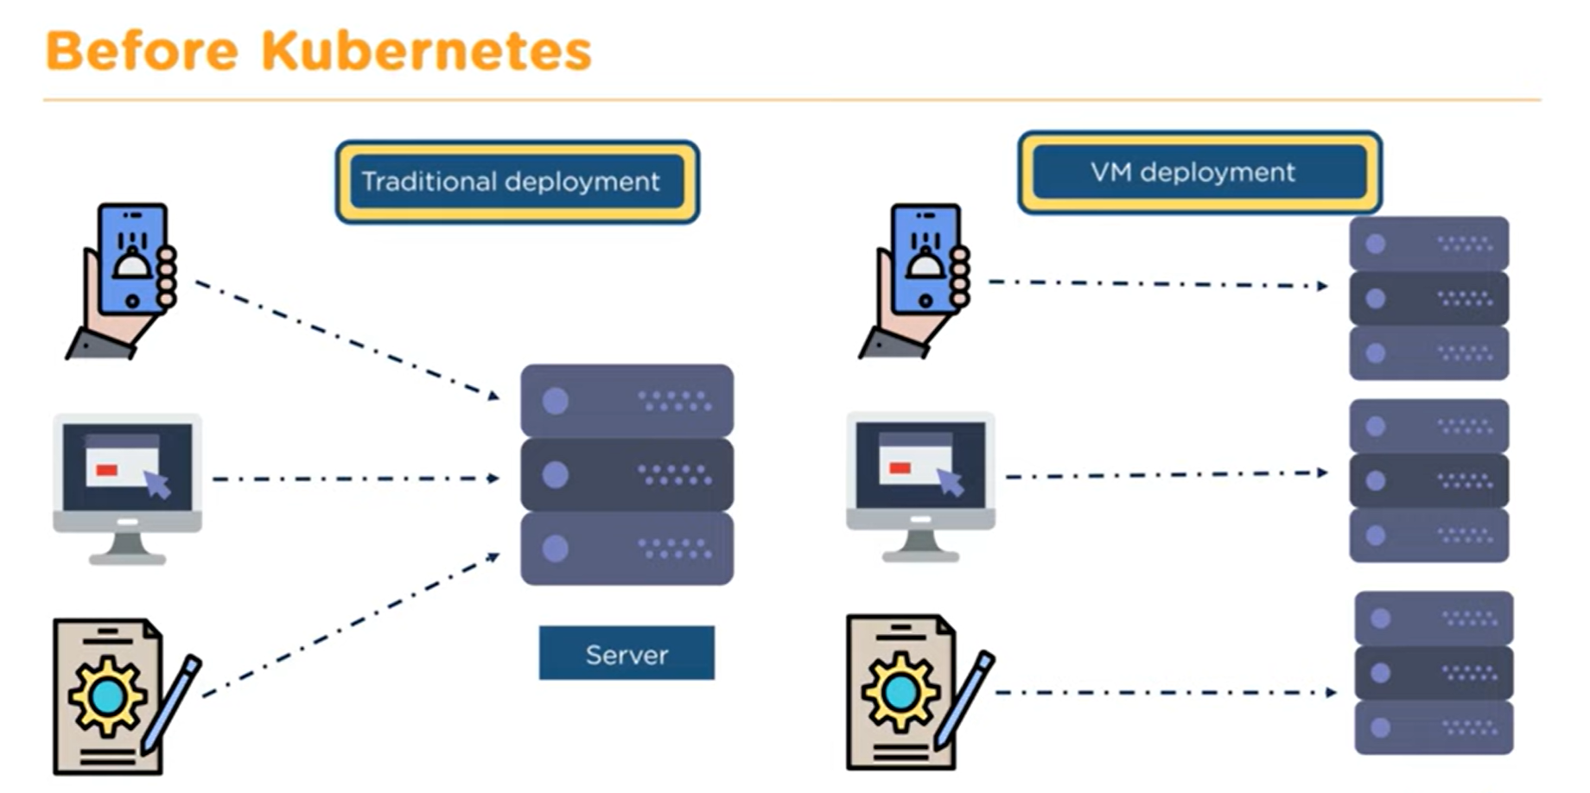
Kubernetes

Slide 55

Kubernetes

Slide 56

Kubernetes

Slide 57

Kubernetes

Slide 58

Kubernetes

Slide 59

Kubernetes

Slide 60

Kubernetes

Slide 61

Kubernetes

Slide 62

Kubernetes

Slide 63

Kubernetes

Slide 64

Kubernetes

Slide 65

Kubernetes

Slide 66

Kubernetes

Slide 67

Kubernetes

Slide 68

Kubernetes

Slide 69

Kubernetes

Slide 70

Kubernetes

Slide 71

Kubernetes

Slide 72

Kubernetes

Slide 73

Kubernetes

Slide 74

Kubernetes

Slide 75

Kubernetes

Slide 76

Kubernetes

Slide 77

Kubernetes

Slide 78

Kubernetes

Slide 79

Kubernetes

Slide 80

Kubernetes

Slide 81

Kubernetes

Slide 82
Microservices
Microservice is a service-based application development methodology. In this methodology, big applications will be divided into smallest independent service units. Microservice is the process of implementing Service-oriented Architecture (SOA) by dividing the entire application as a collection of interconnected services, where each service will serve only one business need.
Microservice is a small, loosely coupled distributed service. Microservice architecture evolved as a solution to the scalability, independently deployable, and innovation challenges with Monolithic architecture
It allows you to take a large application and decompose or break it into easily manageable small components with narrowly defined responsibilities. It is considered the building block of modern applications. Microservices can be written in a variety of programming languages, and frameworks, and each service act as a mini-application on its own. Microservice can be considered as the subset of SOA(Service Oriented Architecture).
A microservice typically implements a set of distinct features or functionality. Each microservice is a mini‑application that has its own architecture and business logic. For example, some microservices expose an API that's consumed by other microservices or by the application's clients, such as third-party integrations with payment gateways and logistics.

Slide 83
Deployment Patterns - There are a few patterns available for deploying microservices. These include the following: Service Instance per Host Service Instance per Container Service instance per Virtual Machine. Multiple service instances per host Benefits of Microservices Small Modules – The application is broken into smaller modules that are easy for developers to code and maintain. Easier Process Adaption – By using microservices, new Technology & Process Adaption becomes easier. You can try new technologies with the newer microservices that we use. Independent scaling – Each microservice can scale independently via X-axis scaling (cloning with more CPU or memory) and Z-axis scaling (sharding), and Y-axis scaling (functional decomposition) based on their needs. Removes dependency – Microservice eliminates long-term commitment to any single technology stack. Unaffected – Large applications remain largely unaffected by the failure of a single module. DURS – Each service can be independently DURS (deployed, updated, replaced, and scaled). Increased Security: –Microservices enable data separation. Each service has its own database, making it harder for hackers to compromise your application. Open Standards: –APIs enable developers to build their microservices using the programming language and technology they prefer.
Microservices

Slide 84
Limitations of Microservices Configuration Management – As it becomes granular the headache comes with configuring the services and monitoring those. You need to maintain configurations for hundreds of components across environments. Debugging – Tracking down the service failure is a painstaking job. You might need to look into multiple services across different components. Centralized Logging and Dashboards are essential to make it easy to debug problems. Automation – Because there are a number of smaller components instead of a monolith, you need to automate everything – Builds, Deployment, Monitoring, etc. Testing – Needs a greater effort for end-to-end testing as it needs all the dependent services to be up and running. Coordination – While handling requests across multiple independent services there is a requirement for proper workflow management
Microservices

Slide 85

Microservices

Slide 86

Microservices

Slide 87

Microservices

Slide 88

Microservices

Slide 89

Microservices

Slide 90

Microservices

Slide 91

Microservices

Slide 92

Microservices

Slide 93

Microservices

Slide 94

Microservices

Slide 95

Microservices

Slide 96

Microservices

Slide 97

Microservices

Slide 98

Git & GitHub

Slide 99

Git & GitHub

Slide 100

Git & GitHub

Slide 101

Git & GitHub

Slide 102

Git & GitHub

Slide 103

Git & GitHub

Slide 104

Git & GitHub

Slide 105

Git & GitHub

Slide 106

Git & GitHub

Slide 107

Git & GitHub

Slide 108

Git & GitHub

Slide 109

Git & GitHub

Slide 110

Git & GitHub

Slide 111

Git & GitHub

Slide 112

Git & GitHub

Slide 113

Git & GitHub

Slide 114

Git & GitHub

Slide 115

Git & GitHub

